Slide 1


The Good, The Bad, The Ugly: Our Region by the Numbers
Dr. Dana Rickman
Georgia Partnership for Excellence in Education
July 18, 2017
Notes:
Introduce the Partnership
Our vision is that all young people in our community will graduate from high school prepared to successfully enroll in higher education, enlist in the military, or become employed in a fulfilling career.
The 4th Annual Education Collaborative Summit will have a special focus on three challenges: how what happens to children from birth to age 5 influences their future success, the overwhelming life issues that make it difficult for some students to succeed, and the transition from high school or college to career

Slide 2
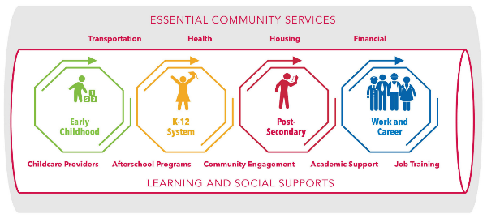
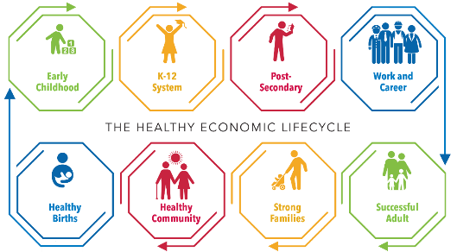


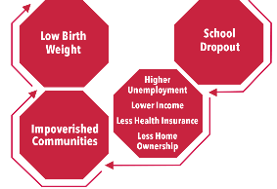
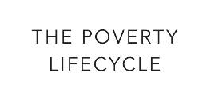
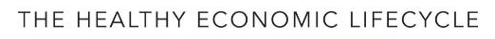

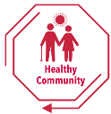


Economic Lifecycles
HOW DO WE MAINTAIN THE PIPELINE?
INSULATE THE PIPELINE!
Notes:
Overall goal is the healthy economic lifecycle.
This presentation is going to help you look at the cracks in your pipeline

Slide 3
Bigger Picture –
The “Demographics” Are A-Changing

Slide 4
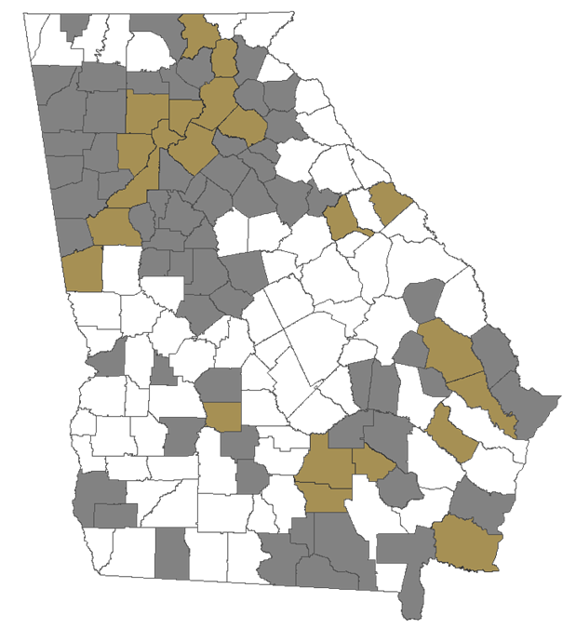
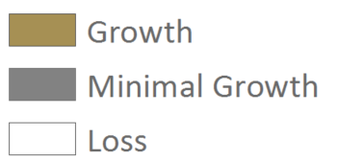
JOB GROWTH
Job Growth
U.S. | 8.3%
GA | 9.6%
Atlanta | 10.4%
Hub | 5.2%
Rural | 3.1%
U.S. | 7.3%
GA | 9.6%
Atlanta | 12.5%
Hub | 8.8%
Rural | 3.3%
2010-2015
2017-2027
Source: JobsEQ, Georgia Chamber of Commerce 2030 2.0
Notes:
What this says: 2010 – 2015: 73 counties lost jobs, 2017-27: 87 counties are projected to lose jobs
75% of the 352,000 jobs projected to be added will be added in Atlanta while only 8% will occur in rural GA. This is an even lower share than their population growth of 15%
Why this matters: These trends are going to show up repeatedly during the remaining slides. We're going to see how job growth and other community stress indicators are related
Atlanta: 11 counties clustered around Atlanta job centers (Douglas)
Hub Counties: 8 counties with job total of more than 65,000 or nexus to a hub county - Athens, Augusta, Savannah, Macon, Columbus
Rural: 140 other counties

Slide 5
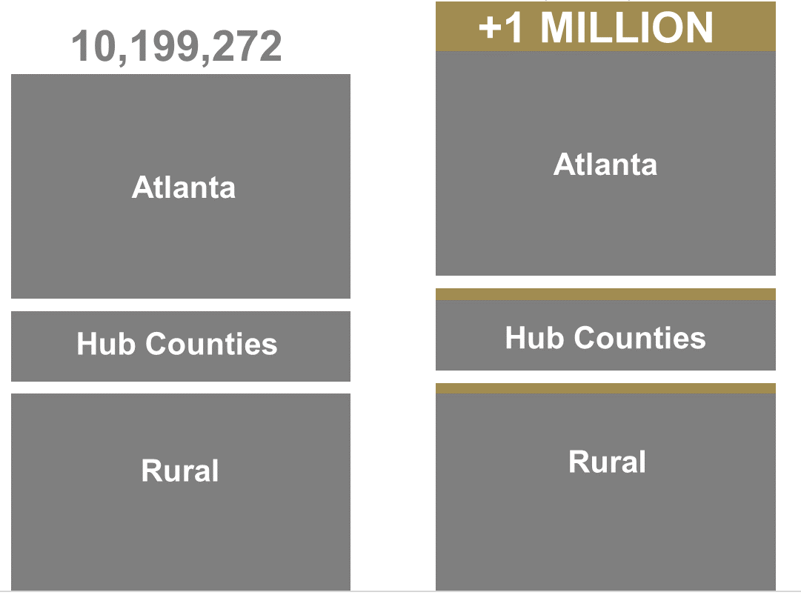
POPULATION GROWTH 2016 TO 2030
Population Growth 2016 to 2030
11,780,382
10,319,696
2016
2030
Source: JobsEQ, Georgia Chamber of Commerce 2030 2.0
Notes:
What this says: Georgia will add 1.5 million people between 2015 and 2030-1MM will be in Atlanta and the remaining 500,000 will be split between hub & rural
74 Counties are projected to lose population or stay at 0
Nearly 70% of the growth will be in Atlanta’s 10 main counties, 17% in the 9 hub city counties, and only 14% in the remaining 140 counties
Why this matters: Population growth is directly tied to job growth. These numbers are similar to national trends, the vast majority of population growth across America is occurring in large metro areas. Smaller metro areas are seeing some growth, but rural areas are seeing either minimal growth or population declines.

Slide 6
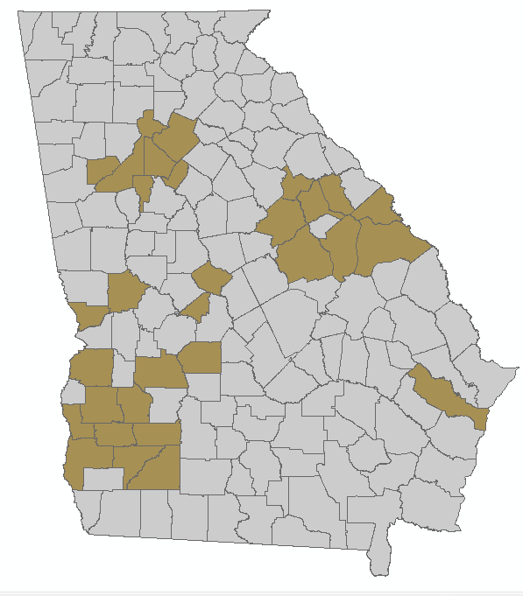
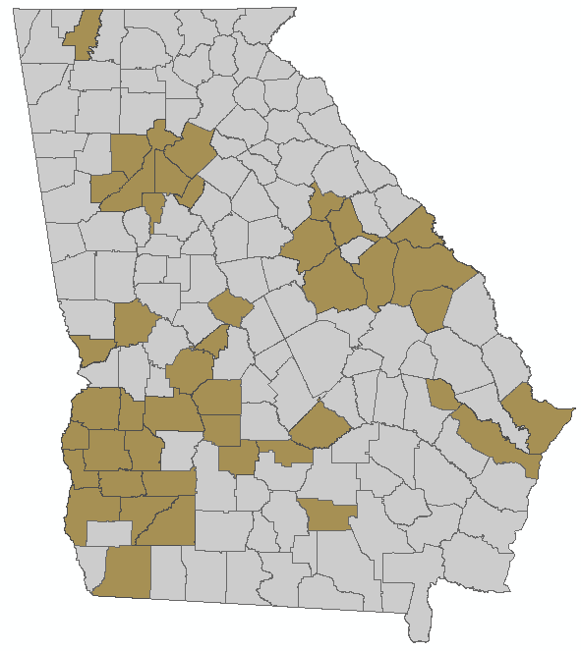
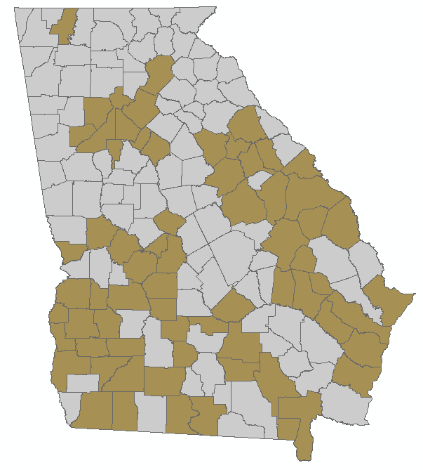

DEMOGRAPHIC PATTERNS: MAJORITY NON-WHITE
Demographic Patterns: Majority Non-white
2010
2030
2050
Source: Woods & Poole, Georgia Chamber of Commerce 2030 2.0
Notes:
What this says: Demographic patterns shifting over time, large number of counties becoming majority non-white, especially in the high growth metro areas
Why this matters: Communities with changing demographics are going to have to deal with conversations about race. Do our elected officials look like the people in our communities? Do our chambers look like the businesses in our communities? These are conversations we've been hesitant to talk about in public, but these are the conversations we have to have. These changes are coming whether we are prepared for them or not. So let's start thinking about how this impacts our politics and our organizations.

Slide 7
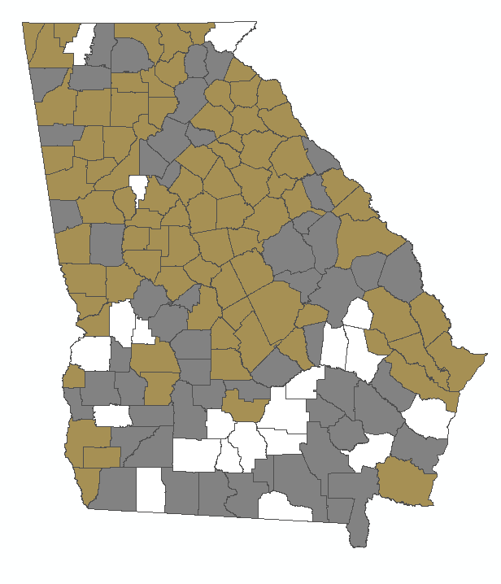
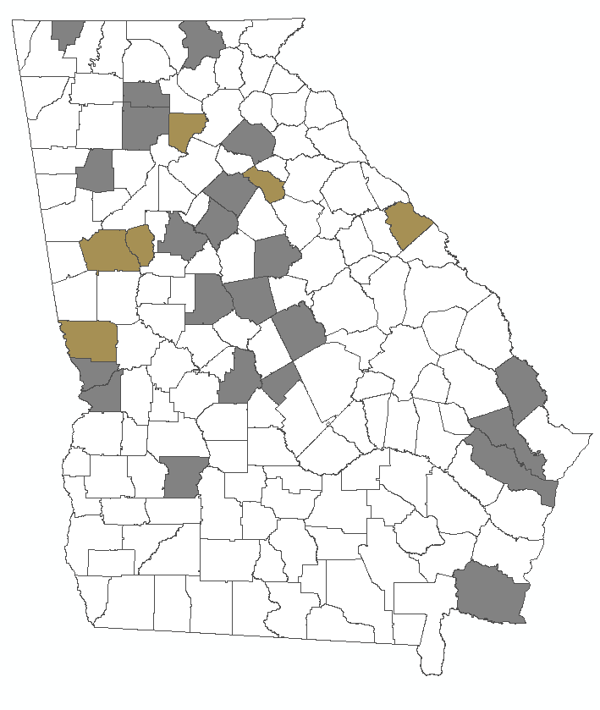
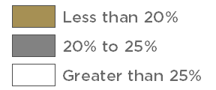
Uninsured Population
U.S. | 11.0%
GA | 18.9%
Atlanta | 19.2%
Hub | 17.4%
Rural | 19.1%
GA | 27.2%
Atlanta | 26.0%
Hub | 26.8%
Rural | 28.3%
2017
2023
Source: Georgia Chamber Quality Healthcare Access Study, Georgia Chamber of Commerce 2030, 2.0
Notes:
What this shows:
21 counties currently have greater than 25% uninsured
If no healthcare reform is passed and status quo is maintained, the number of counties with 25% or greater uninsured will skyrocket to 131 counties
Rank among top 5 for highest uninsured rates
Why this matters: Healthcare drives a huge portion of our state economy and our local economies. The current path is unsustainable. As insurance becomes more expensive, businesses will have to continue to dedicate more resources to employer sponsored insurance. This problem cuts across every type of community I every part of the state.

Slide 8
Birth to Age 5 -
Influences on the Future

Slide 9

Determinants that Affect Children’s Ability to Read

Slide 10
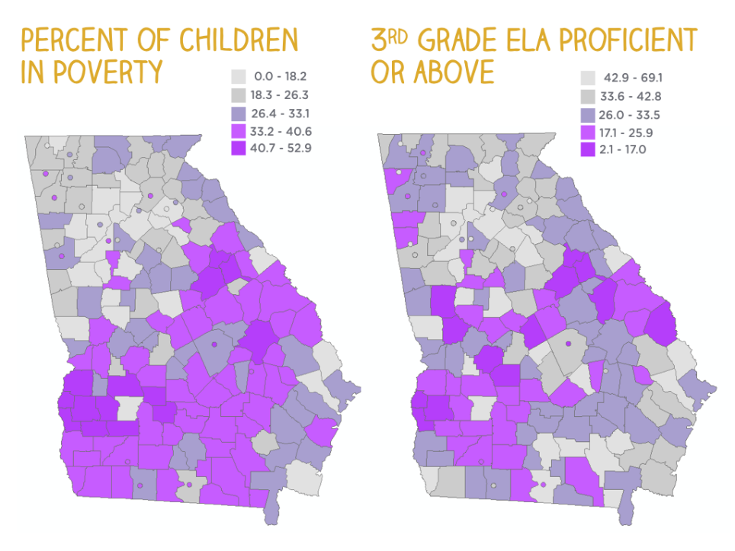
Percent of Children
3rd Grade ELA Proficient
in Poverty
or Above

Slide 11
Children Living in Poverty
Source: Georgia Kids Count, Georgia Family Connection Partnership, http://www.gafcp.org

Slide 12
Low-Birthweight Babies
Source: Georgia Kids Count, Georgia Family Connection Partnership, http://www.gafcp.org

Slide 13
Maternal Education:
Babies born to mothers with less than 12 years of education
Source: Georgia Kids Count, Georgia Family Connection Partnership, http://www.gafcp.org

Slide 14
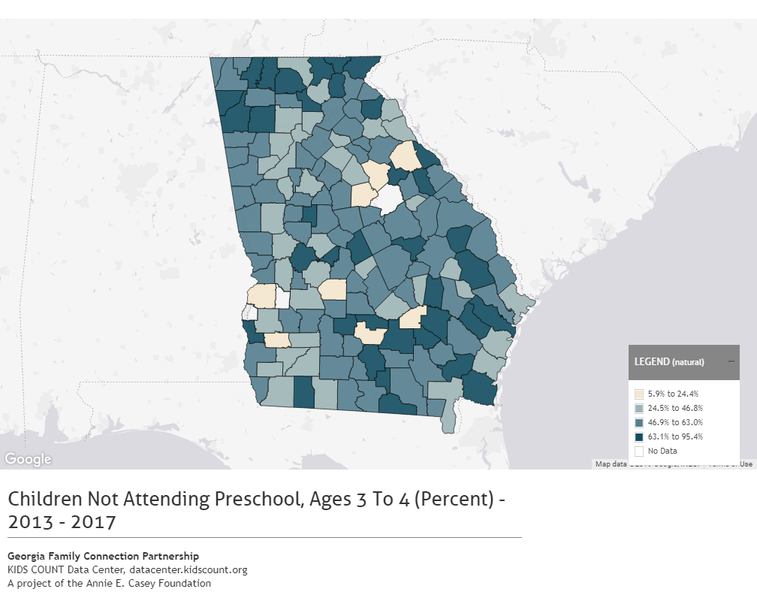
Children not Attending Preschool, Ages 3 to 4 (percent)
2013 - 2017
Notes:
Carrol – 58.2
Coweta – 51.3
Douglas – 45
Haralson – 52.8
Heard - - 54.6

Slide 15
Achievement Gaps
*Source: National Assessment of Educational Progress, 2017 Percent of students proficient and above
**Source: Georgia Department of Education, 2018 High School Graduation Rate
Notes:
Disconnect – need the foundation to make sure ALL kids are reading on grade level.
Can’t do business as usual – we will fail.

Slide 16
The Great Equalizer
*Source: Governor’s Office of Student Achievement: How Do Students’ 3rd Grade Reading Levels Relate to their ACT/SAT and Chance of Graduating from HS?

Slide 17
Overwhelming Life Issues

Slide 18
Teen Pregnancies
Ages 15-17 (rate per 1,000)
Source: Georgia Kids Count, Georgia Family Connection Partnership, http://www.gafcp.org
Notes:
Heard had lots of missing data due to low population numbers - 2013 – 39.8 (10 pregnancies) 2016 24.6 (6)

Slide 19
Instances of Child Abuse/ Neglect:
Rate per 1,000
Source: Georgia Kids Count, Georgia Family Connection Partnership, http://www.gafcp.org

Slide 20
Violent Crimes
Committed by age 17 or older (Rate per 1,000)
Source: Georgia Kids Count, Georgia Family Connection Partnership, http://www.gafcp.org
Notes:
Definitions: Numerator: Number of violent crimes (part I
Part 1 crimes include Murder and Non-negligent Manslaughter, Manslaughter by Negligence, Forcible Rape, Robbery, Aggravated Assault, Burglary-Breaking or Entering, Larceny-Theft (Except Motor Vehicle Theft), Motor Vehicle Theft, and Arson. crimes) committed by persons 17 years of age or older. Denominator: Population ages 17 and older. Rates Calculation: 1,000 times the numerator divided by the denominator.

Slide 21
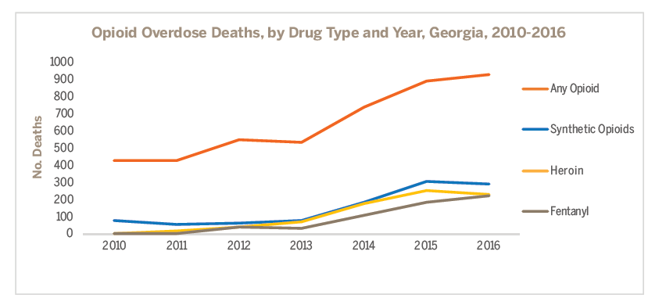
Drug Epidemic
Source: Opioid Overdose Surveillance, Georgia 2016, DPH
County Rank (Rate per 100,000 Population) | Any Opioid-Involved Overdose Death Rate (Among Counties withe >15 Deaths)
1. Carroll | 21.2
2. Walton | 17.3
3. Douglas | 16.3
4. Bartow | 15.8
5. Richmond | 14.7
6. Cobb | 13.8
7. Fulton | 13.1
8. Paulding | 12.8
9. Chatham | 10.6
10. Cherokee | 10

Slide 22
Transitioning From High School to College or Career

Slide 23

The Missing 57%
100 Georgia 9th Graders Enter High School!
81 graduate HS
62 enroll in higher education
43 make it to their sophomore year
Source: Ga DOE data for 2016-2017 school year; projections by Atlanta Regional Commission
Notes:
Source: Ga DOE 2012-2013 school year, calculations by Atlanta Regional Commission estimates

Slide 24
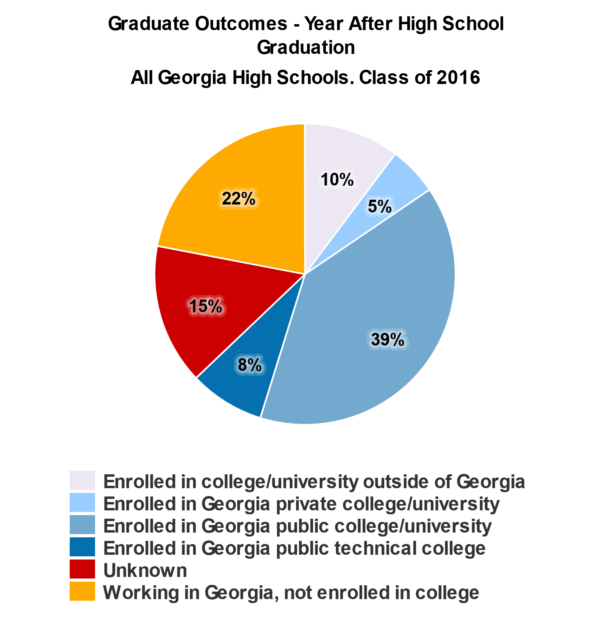
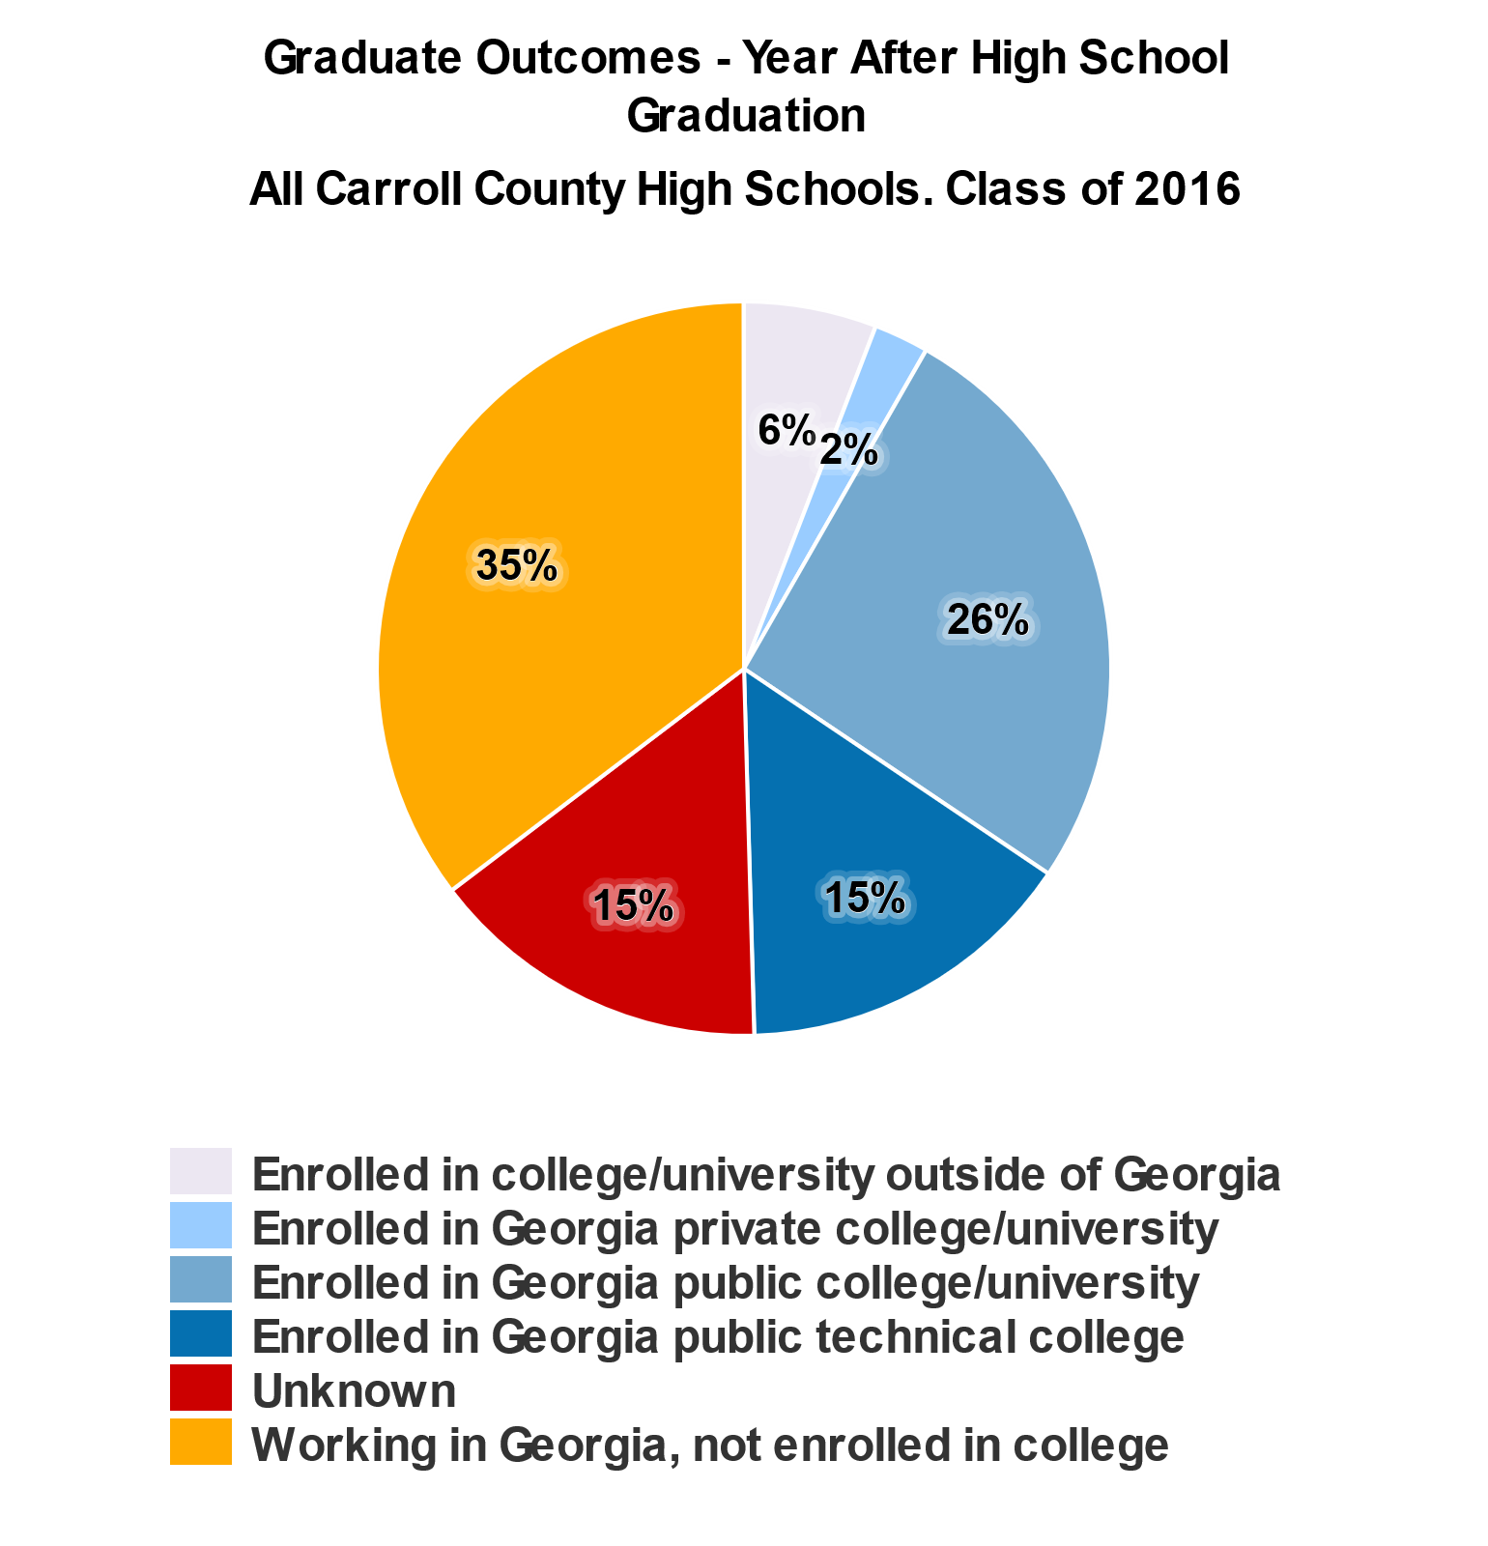
HS Graduation Enrollment Trends
Source: Governors Office of Student Achievement (GOSA): High School Graduation Outcomes Report
Notes:
2018 rates
Georgia – 82%
Carroll County – 92%
2016 – Carroll 86%
Georgia – 79%
Georgia – 63% went into post-sec
Carroll – 50% went into post-sec

Slide 25
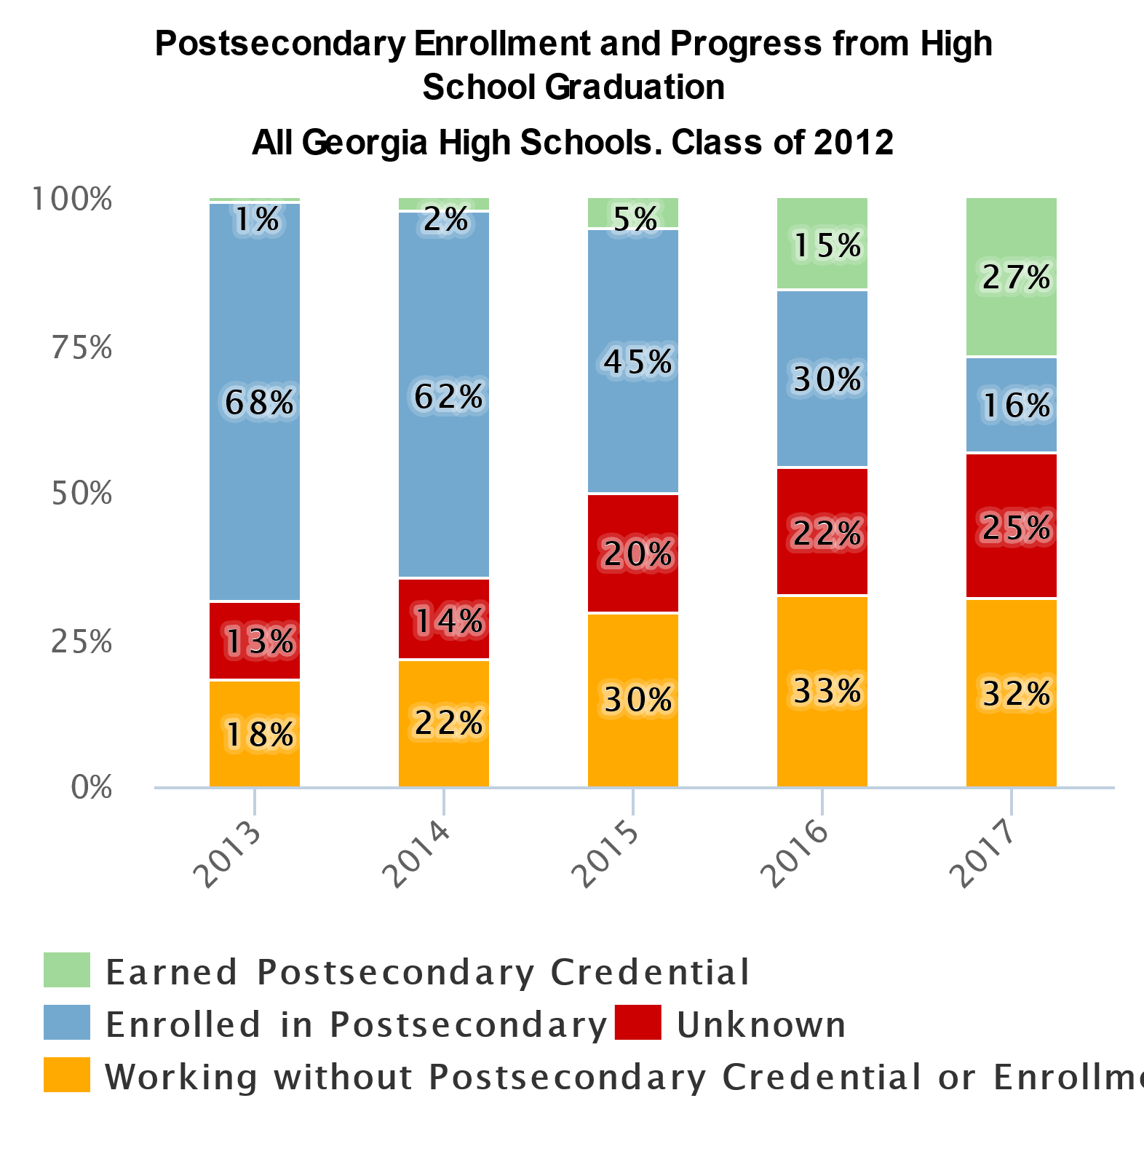
Post-Secondary Access and Completion
Source: Governors Office of Student Achievement (GOSA): High School Graduation Outcomes Report

Slide 26
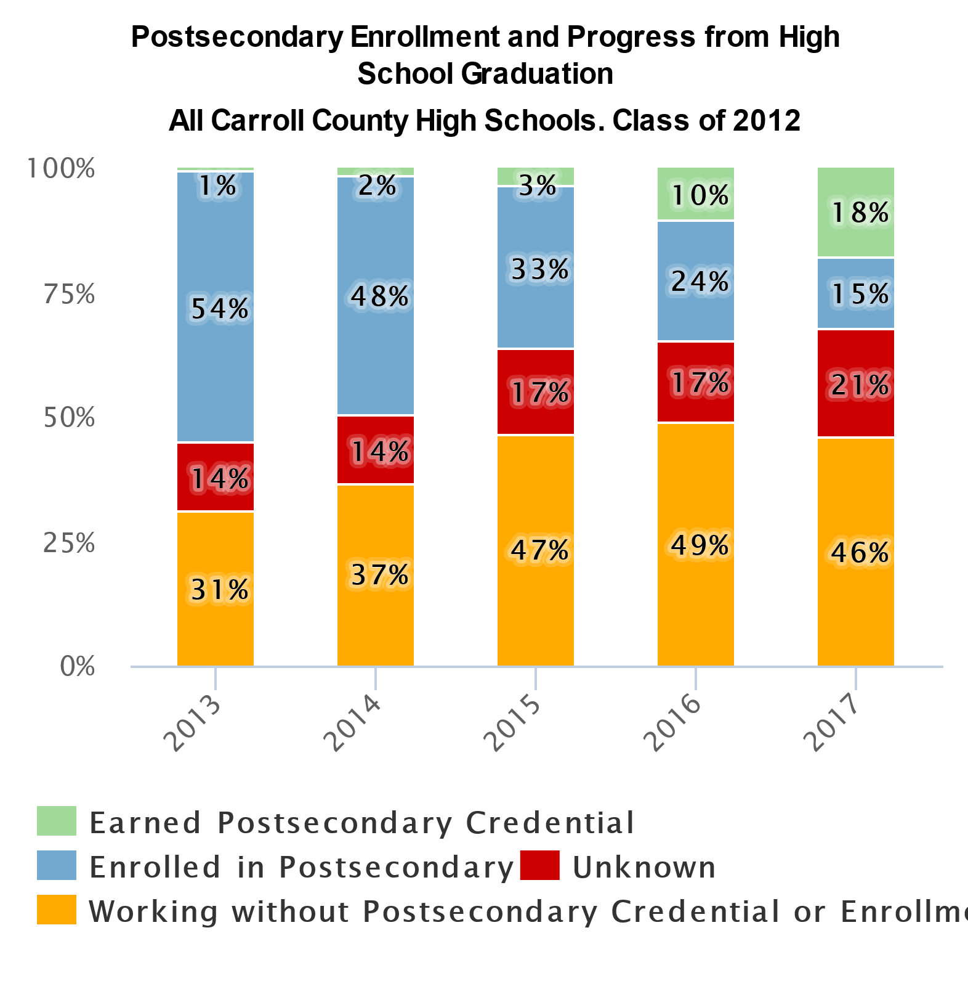
Post-Secondary Access and Completion
Source: Governors Office of Student Achievement (GOSA): High School Graduation Outcomes Report
Notes:
76% graduation rate

Slide 27
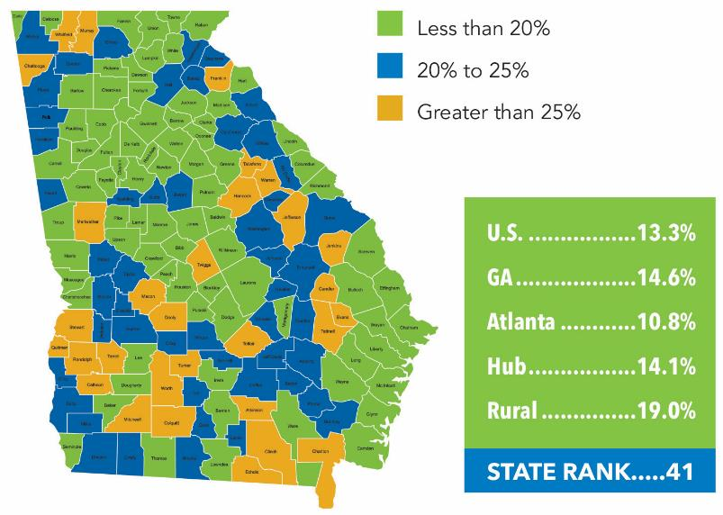
Barriers to Economic Growth:
Adults Without A High School Diploma
Compiled by Georgia Chamber of Commerce 2030, ACS 2015 5-Year estimates

Slide 28
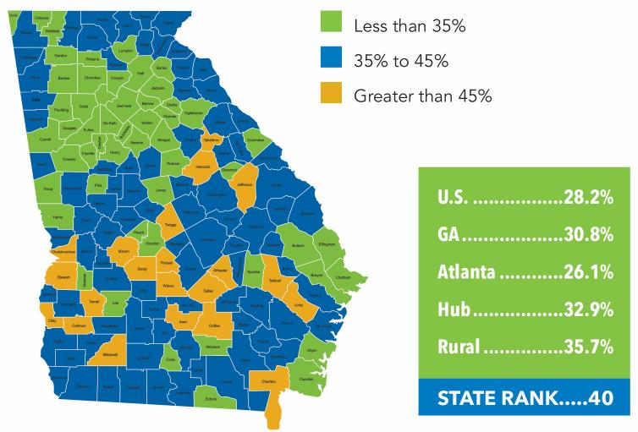
Barriers to Economic Growth:
Adults Not Working, Ages 25-64
Compiled by Georgia Chamber of Commerce 2030, ACS 2015 5-Year estimates
Notes:
Challenge for communities – how to do you re-enegage the adult population in the workforce. Why are they out of it? Job training? Literacy? Education levels?

Slide 29
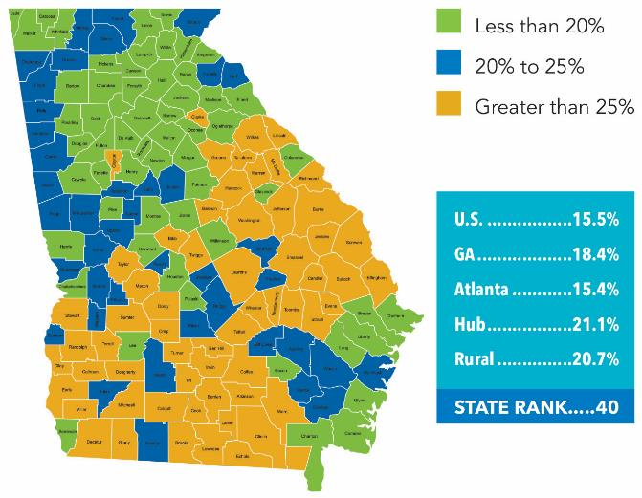
Barriers to Economic Growth: Poverty Rates
ACS 2015 5-year estimates/Kids Counts Data Center
Notes:
Calculations done by the Georgia Chamber of Commerce
Adult population
59 of Georgia’s 159 counties have greater than 25% poverty
Lowest Poverty Rate – Forsyth and Oconee (7%)
Highest Poverty Rate – Calhoun and Clay – 42% of the residents are below the official poverty threshold

Slide 30
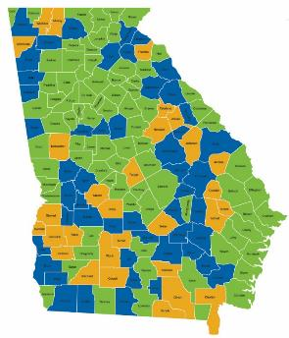
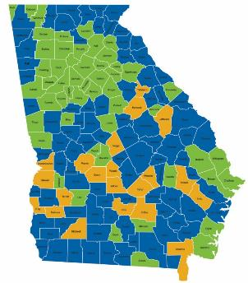
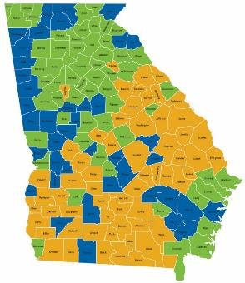
Barriers to Economic Growth
No HS Diploma
Adults Not Working
Poverty
Notes:
Doug Betchel – UGA professor – started with the 2 Georgia’s. Before he passed away, he updated that to the 5 Georgia’s: Urban, Urbanizing, Suburban, Rural Growth, Rural Decline
Rest of the state is important. Statewide agencies, statewide presence. Also, Atlanta can’t continue to support the rest of the state.

Slide 31
Aligning Educational Strategies for
Collective Impact
Random Acts of Improvement
GOALS
Partially Aligned Acts of Improvement
GOALS
Aligned Acts of Improvement
GOALS
Notes:
If your efforts are not aligned, whether in business or schools, it’s going to be harder to stay focused and reach your goal. How many of your schools have random acts that compete against each other?
If we are all aimed in the same direction with focus on the same goal, it can be reached. In business, that goal is profits; in education, that goal is student achievement.
Slide transition statement – Now, we want to take some time for you all to reflect on how to align your acts of improvement around your goals.

Slide 32

Connect with us
Twitter: @GAPartnership
Facebook: Georgia Partnership for Excellence in Education
Instagram: @GAPARTNERSHIP
LinkedIn: Georgia Partnership for Excellence in Education
Website: www.gpee.org

