Slide 1

Notes:
Intro to Ga Partnership

Slide 2

Top Ten Issues - 2019
(1) New Leadership – Changes at the Capitol
(6) Assessments – Testing the Waters
(2) Early Learning – Quality Early Care and Its Economic Impact
(7) ESAs/ Vouchers – Taking a Hard Look at What’s Next
(3) Teaching – Elevating the Profession…Now!
(8) Summer Start Date – More than Meets the Eye
(4) School Safety – Much More than Metal Detectors
(9) Dual Enrollment – Growth and Sustainability
(5) Funding: Is Fully Funding QBE Enough?
(10) Post-Secondary – Costs, Other Barriers Impede Success
Notes:
Leadership - New governor, new house and potentially senate education leadership. New gov new appointments to education state agency boards and leadership. What will that mean for education policy moving forward?
Gov elect has indicated his support for Gov. Deal’s work on prioritizing early learning, Richard Woods still at DOE, not heard much of anything about higher ed. Leadership is a recurring theme throughout all of our subsequent 9 issues.
2. Early learning - The Georgia Early Education Alliance for Ready Students (GEEARS) and the Metro Atlanta Chamber of Commerce conducted a survey of parents with young children. The poll found that over the previous year, 25% reported that they or someone in their family had to quit a job, not accept a job, or greatly change their job because of problems with child care. Further estimated an annual loss to the state economy $1.75 billion, with subsequent lost tax revenue of $105 million. More about this issue in our closing panel this afternoon.
3. Teaching – talking about this forever. More about this in a minute…
4. School Safety - A comprehensive framework for school safety includes the physical safety of the building and also addresses issues of school climate, discipline, and the behavioral health of students and faculty5. Funding – Still don’t know how much it costs.
6. Assessments - Yep. Still a thing. District waivers, applied for federal waivers. How do we assess better? Allison Timberlake is going to talk with us later today to talk about this in detail.
7. ESAs/ Vouchers - Charter schools are a settled discussion in Ga, new frontiers of ‘choice’ are now around vouchers, SSOs, and discussions are gaining around the idea of Education Savings Accounts. We expect to see more legislation around these areas in 2019.
8. Summer Start date - IT’s really hot in early August. Talk about this one in detail in a sec.
9. Dual Enrollment – over past 5 years - 49% participation increase over the past 5 years, 133% increase in state spending. Looks at questions related to growth and sustainability. Also, equity of access – low engagement low income students, though beginning to narrow, and program overly proscribed by white students.
10. Post-Sec Barriers –A 2017 survey found that in Georgia, about
8.7% of post-secondary students experienced some form of homelessness,
39% were housing insecure

Slide 3
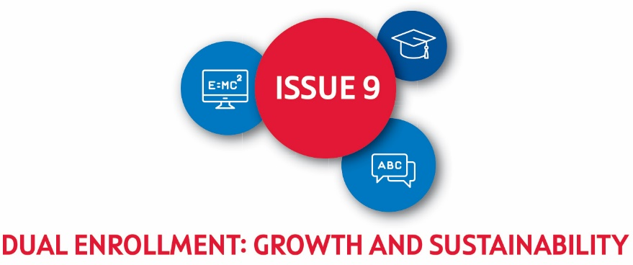
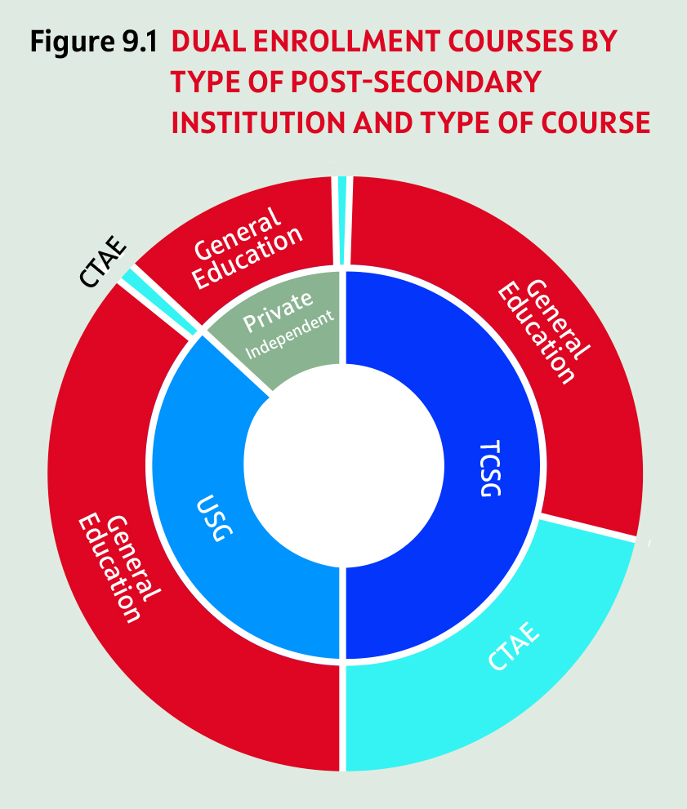
Dual Enrollment Student Outcomes
Dual enrollment credit hours attempted: 94% passed
Graduated from high school within 4 years in 2017: 94% (GA 74%)
Enrolled in a postsecondary institution within a year of graduating: 83% (GA 64%)
Earned a postsecondary credential four years after high school graduation: 29% (GA 17%)
Notes:
Georgia’s Dual Enrollment program is open to all high school students. Through the program, students can complete an unlimited number of courses at postsecondary institutions prior to high school graduation. Students become eligible for the coursework by meeting specific admissions requirements which vary by institution and course.
Requirements vary by TCSG course and institution, but in some cases minimum criteria provides the opportunity to become eligible through either traditional entry criteria (such as GPA or ACT/SAT scores), or non-traditional measures (such as PSAT scores, Georgia Milestones results, or other approved placement test scores).
Most classes are delivered at postsecondary institutions (74%), while less are delivered at high school campuses (17%) or online (9%). Ibid.
TCSG institutions provided nearly 50% (TCSG institutions also deliver the most dual enrollment courses to students at high school campuses.⁾
Overall – general ed (78%) CTAE 22%

Slide 4
Over the past 5 years (FY 13-FY 17) increases in:
  Total attempted credit hours – 258%
    Students participating in the program – 212%
    Number of credit hour attempted – 15%
  Appropriations – 325% ($18.5M to $78.8M)
Notes:
What’s driving the increase?
Stream lined under “Move on When Ready Act” (2015)
A. The program consolidates three prior state funded programs into one named Dual Enrollment.
opening enrollment to all Georgia high school students,
removes financial disincentives experienced by local school systems, which lost Quality Basic Education (QBE) funding for dual enrolled students under previous programs.
B. expanding admissions criteria TCSG is developing to promote access for more students to become eligible. Requirements vary by TCSG course and institution, but in some cases minimum criteria provides the opportunity to become eligible through either traditional entry criteria (such as GPA or ACT/SAT scores), or non-traditional measures (such as PSAT scores, Georgia Milestones results, or other approved placement test scores).
Funding:
Georgia is one of five states where the state is responsible for paying a student's dual enrollment tuition - (NM, NC, Tn, Utah – state/ student)
Georgia Student Finance Commission (GSFC) via an annual appropriation from the General Assembly, which is then distributed to postsecondary institutions. Postsecondary institutions waive all mandatory and noncourse related student fees; provide course books at no charge to the student; and accept the amount paid by the commission as full payment for high school students’ tuition, fees, and course books. The state also provides enrollment-based formula funding to USG and TCSG institutions and provides QBE funding to local K-12 school districts for the portion of the day students take dual enrollment courses.
Georgia is making a decisive public investment in the program -- a recent Brookings analysis shows that state costs for a dual enrollment course were 60% higher than if the student took the community college course via direct enrollment after completing high school.

Slide 5
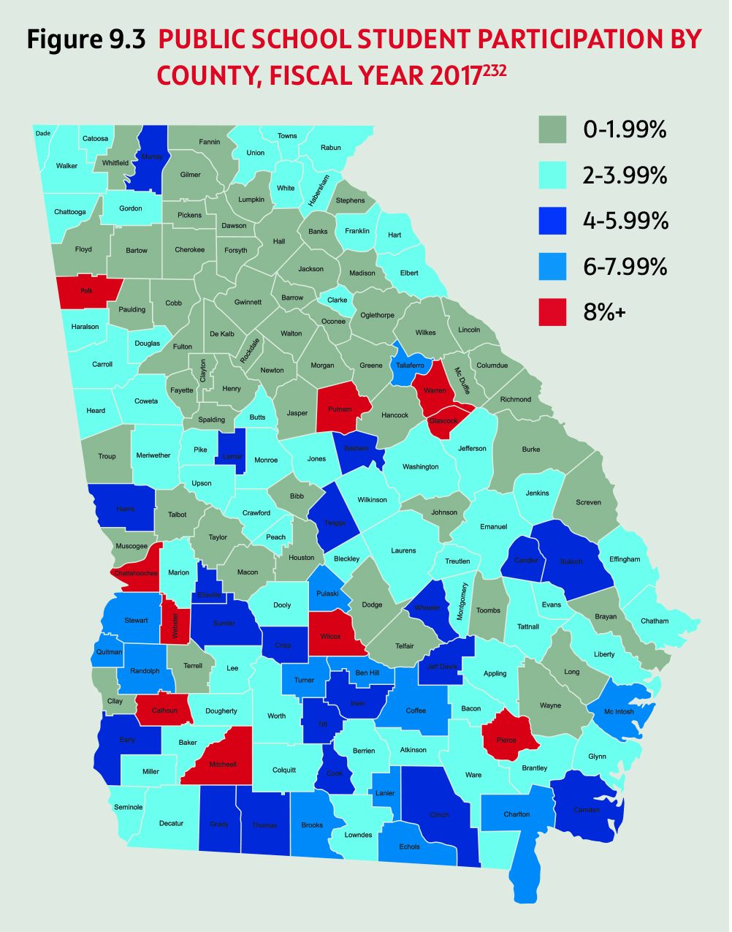
Source: Ga Department of Audits, Dual Enrollment Report No. 17-09

Slide 6
Post-Secondary Institution | Enrollment Rank by Total Credit Hours | Total Enrollment (Fall ‘16) | Dual Enrollment (Fall ‘16) | % of Total Enrollment
Ga Military College | 1 | 8,234 | 1,332 | 16%
Ga State University | 2 | 50,969 | 1,863 | 3.7%
Ga Northwestern Tech. | 3 | 6,018 | 1,757 | 29.2%
West Ga Tech. | 4 | 6,744 | 1,079 | 29.2%
Chattahoochee Tech. | 5 | 10,000 | 1,003 | 10.0%
Wiregrass Tech. | 6 | 3,940 | 1,426 | 36.2%
Coastal Plains Tech. | 7 | 2,775 | 1,113 | 40.1%
Truett McConnell Univ. | 8 | 2,149 | 1,410 | 65.6%
University of North Ga. | 9 | 18,219 | 852 | 4.7%
Southern Regional Tech. | 10 | 3,527 | 1,155 | 32.7%
Source: Ga Department of Audits, Dual Enrollment Report No. 17-09

Slide 7
Notes:
In the development of these goals, the legislature must answer a question about the role the program should play in addressing the state’s workforce and equity needs. Is the purpose of the program to extend higher education access to all students throughout the state? Increase the percentage of students enrolling in college? Shorten time to postsecondary degree completion? Increase high school and postsecondary degree attainment?
Note, GSFC and USG have issued statements of support for creating goals and objectives for the program, and USG suggests aligning them with the Complete College Georgia initiative.

Slide 8
HB 444 – Main Points
  Removes 9th graders from participating
  Limits students attending a USG institution to 11th and 12th graders
    30 hours
    Authorized HOPE to cover past 30
  10th - 12th graders can participate at TCSG institutions
  Counseling required
Issue to Consider
  Two Tracks
    USG – focus on getting college credits
    TCSG – can take classes that count towards HS core courses and complete certificate/ associate degree program, would then be granted a HS diploma
  Purpose of Dual Enrollment
Notes:
New amendments in Senate – cover up to 32 hours academic course work, 63 hours of technical ed.
Allows 9th and 10th graders
Legislated HS GPA re
requirements – 3.0 university system, 2.6 TCSG, 2.0 technical ed courses in high-demand careers.
House:
Increase secondary and postsecondary success rates and degree attainment by 20 students
Expose students who are at risk of dropping out of high school or who are not planning to pursue postsecondary education to dual credit courses so that such dual credit courses can set them on a path toward obtaining a postsecondary credential;
Decrease the amount of time it takes for students to complete their degrees at 28 postsecondary institutions.
Increase the percentage of students enrolling in postsecondary institutions after high 32 school graduation.
Senate version:
The purpose of the dual enrollment program shall be to provide qualified high school 20 students with access to rigorous career and academic courses at higher education 21 institutions in order to increase high school graduation rates, prepare a skilled workforce, 22 and to decrease postsecondary students' time to degree completion

Slide 9

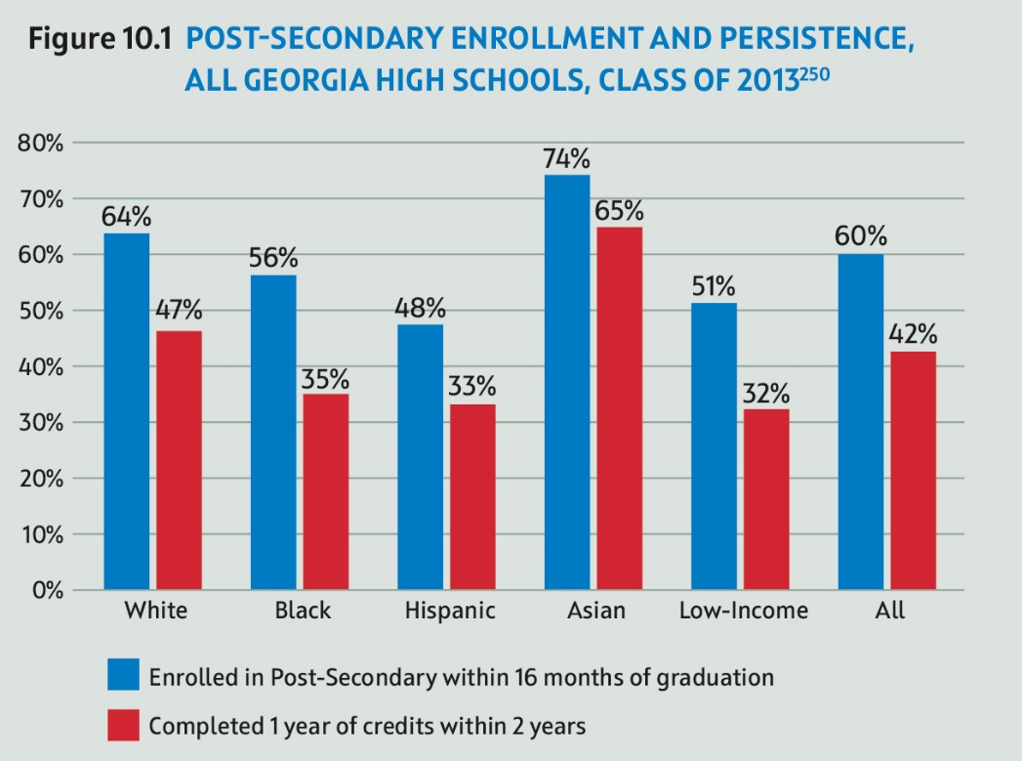
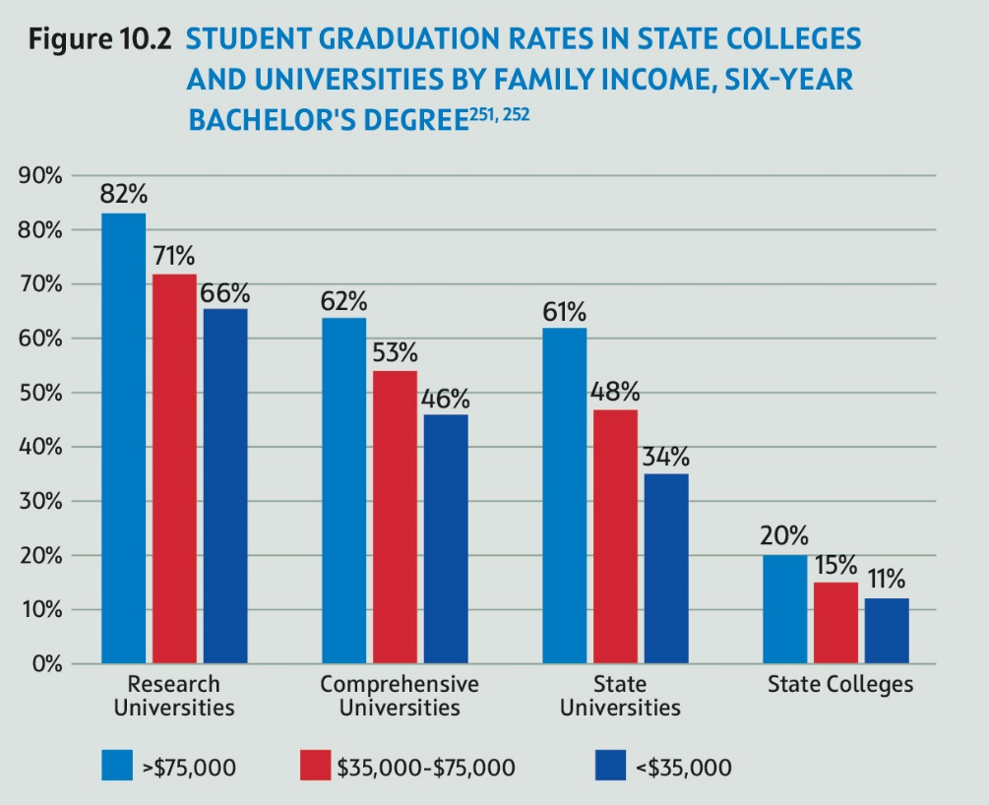
Notes:
p. 67

Slide 10
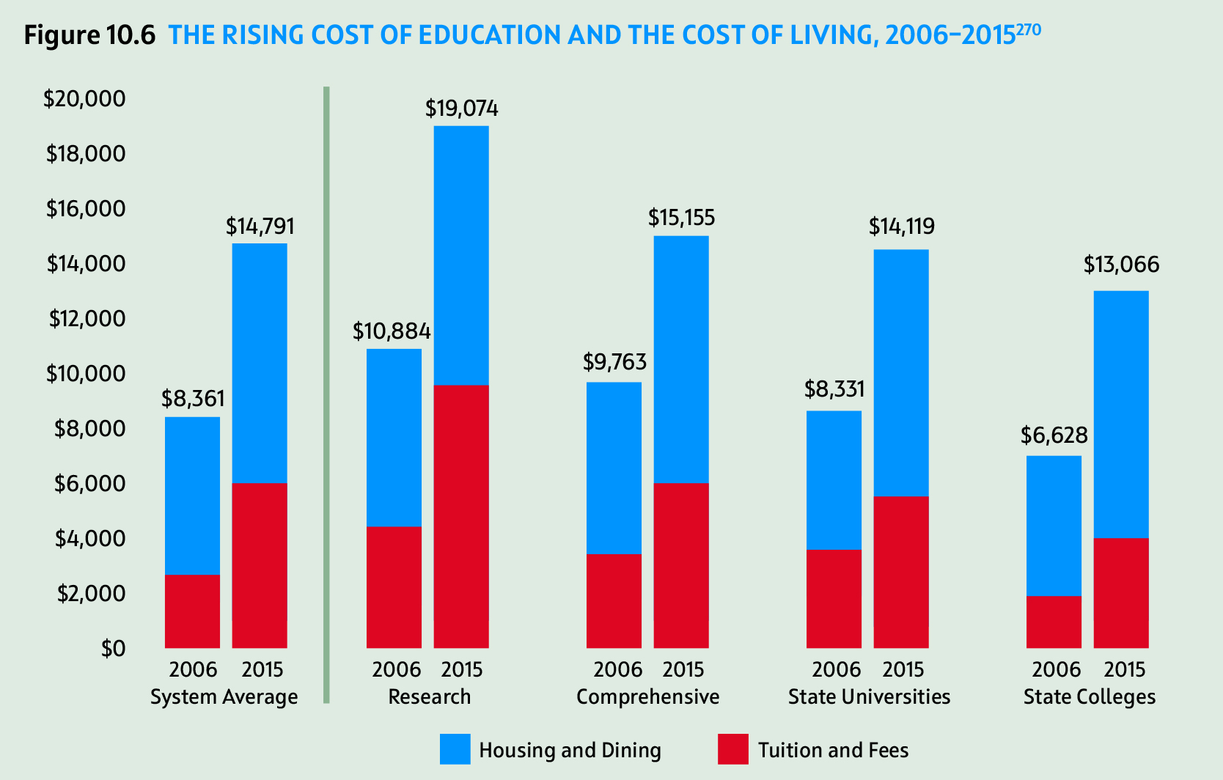
Notes:
Figure 10.6 – page 71
A 2017 survey found that in Georgia, about
8.7% of post-secondary students experienced some form of homelessness,
39% were housing insecure
These numbers are slightly higher than national averages

Slide 11
HB 787 – statewide needs-based aid program
  Unlikely
  Shifting toward Completion Grant model similar to GSU’s Panther Grants
Complete College Georgia Initiative
  College Readiness: Mending the P-12 pipeline to increase the number of high school students who graduate and are ready to begin higher education work
  Improving Access and Completion among Underserved Students: Identifying and removing common barriers for minority, part-time, adult, military, disabled, low-income, and first-generation students
  Shortening the Time to Degree: Improving current paths and developing new paths for students to earn a high-quality degree in a timely manner
  Restructuring Instructional Delivery: Improving the quality of student learning through effective teaching, facilitation, and innovative modes of learning
  Transforming Remediation: Improving remedial education practices to remove barriers and increase success.
Notes:
787 - which authorized a needs-based aid program for low-income students. Bill targets students “whose families are considered economically disadvantaged,” the definition if disadvantage is yet to be determined. More significantly, no funding source has been identified, for which the Georgia Student Finance Commission has estimated an initial cost of between $25 and $40 million.

Slide 12
Top Ten Issues - 2019
(1) New Leadership – Changes at the Capitol
(6) Assessments – Testing the Waters
(2) Early Learning – Quality Early Care and Its Economic Impact
(7) ESAs/ Vouchers – Taking a Hard Look at What’s Next
(3) Teaching – Elevating the Profession…Now!
(8) Summer Start Date – More than Meets the Eye
(4) School Safety – Much More than Metal Detectors
(9) Dual Enrollment – Growth and Sustainability
(5) Funding: Is Fully Funding QBE Enough?
(10) Post-Secondary – Costs, Other Barriers Impede Success
Notes:
Leadership - New governor, new house and potentially senate education leadership. New gov new appointments to education state agency boards and leadership. What will that mean for education policy moving forward?
Gov elect has indicated his support for Gov. Deal’s work on prioritizing early learning, Richard Woods still at DOE, not heard much of anything about higher ed. Leadership is a recurring theme throughout all of our subsequent 9 issues.
2. Early learning - The Georgia Early Education Alliance for Ready Students (GEEARS) and the Metro Atlanta Chamber of Commerce conducted a survey of parents with young children. The poll found that over the previous year, 25% reported that they or someone in their family had to quit a job, not accept a job, or greatly change their job because of problems with child care. Further estimated an annual loss to the state economy $1.75 billion, with subsequent lost tax revenue of $105 million. More about this issue in our closing panel this afternoon.
3. Teaching – talking about this forever. More about this in a minute…
4. School Safety - A comprehensive framework for school safety includes the physical safety of the building and also addresses issues of school climate, discipline, and the behavioral health of students and faculty5. Funding – Still don’t know how much it costs.
6. Assessments - Yep. Still a thing. District waivers, applied for federal waivers. How do we assess better? Allison Timberlake is going to talk with us later today to talk about this in detail.
7. ESAs/ Vouchers - Charter schools are a settled discussion in Ga, new frontiers of ‘choice’ are now around vouchers, SSOs, and discussions are gaining around the idea of Education Savings Accounts. We expect to see more legislation around these areas in 2019.
8. Summer Start date - IT’s really hot in early August. Talk about this one in detail in a sec.
9. Dual Enrollment – over past 5 years - 49% participation increase over the past 5 years, 133% increase in state spending. Looks at questions related to growth and sustainability. Also, equity of access – low engagement low income students, though beginning to narrow, and program overly proscribed by white students.
10. Post-Sec Barriers –A 2017 survey found that in Georgia, about
8.7% of post-secondary students experienced some form of homelessness,
39% were housing insecure

Slide 13
Questions Welcome Now & Anytime!
Dana Rickman
Vice President
drickman@gpee.org
404.223.2462

