Slide 1


Cultivating your Workforce Pipeline
Educational Interventions
for Economic Development
Merrill Wilcox
Tuesday, July 23, 2019
Rural Prosperity Forum – North Georgia
Notes:
How many of you think your talent pipeline, your workforce, is a big deal? Well, your workforce pipeline is your ed pipeline

Slide 2
Today’s Goals
Understanding the Workforce Pipeline
Impacting the Workforce Pipeline
Making a plan for your community
Taking steps to cultivate your local talent

Slide 3
Economic Impacts – The Graduation Effect
If Georgia’s Graduation Rate increased to 90%
$160 million in additional income
$10.5 million in state and local tax revenue
$600 million on health-care cost savings
$260 million in home sales
Source: Alliance for Excellent Education’s “The Graduation Effect” with support from State Farm; http//impact.all4ed.org/
Notes:
Do you know what we’re at today? 82%.

Slide 4
Education Pays
EDUCATIONAL ATTAINMENT & EMPLOYMENT
Unemployment % Rate* |  |  |  |  |  |  |  | May 2019 | Approx. Annual Earnings**
 |  |  |  |  |  |  | 2.1% | Bachelor’s Degree & Higher | $70,200
 |  |  |  |  |  | 2.8% |  | Some college/ Associate Degree | $43,420
 |  |  | 3.5% |  |  |  |  | HS Graduates, No College | $38,428
 | 5.4% |  |  |  |  |  |  | Less than a High School Diploma | $30,056
Source: *U.S. Bureau of Labor Statistics Table A-4. Employment status of the civilian population 25 years and over by educational attainment.
**U.S. Bureau of Labor Statistics Table 5. Quartiles of usual weekly earnings of full-time wage and salary workers, approximation based on median earnings.
Notes:
Not just about income– income is great, but this is about stability. Income and stability are how this effects the community at large.

Slide 5

The Missing 57%
100 Georgia 9th Graders Enter High School!
82 graduate HS
62 enroll in higher education
43 make it to their sophomore year
Source: Ga DOE data for 2016-2017 school year; projections by Atlanta Regional Commission
Notes:
Source: Ga DOE 2012-2013 school year, calculations by Atlanta Regional Commission estimates

Slide 6
Academic Achievement Milestones
School Readiness
Literacy by 3rd Grade
Numeracy by 8th Grade
High School Graduation
Workforce and/or College Ready
Notes:
This slide will be used as data organizer – begin with something like “The data we are about to see is the foundation for moving a child from early learning to a successful college/ career pathway…”
As we move through the presentation, we will talk about major milestones that lead to academic achievement…
School readiness
Literacy by 3rd grade
Numeracy by 8th grade
High School Graduation
Learn4Life - Metro Atlanta Regional Education Partnership is using these milestones to track and improve education outcomes for the Atlanta region.
Research says we can’t wait until the end of the pipeline, we must address each of these milestones along the way.

Slide 7
NAEP 4th Grade Reading
Percent At or Above Proficient
Notes:
This is proficient and advanced
NAEP score cut offs are: below basic, basic, proficient, advanced
Proficient is the level that is aligned with other college/ career ready standards: Common Core, ACT, Sat, etc.
NAEP is given to a sample of students administered every other year. It is currently the only assessment that allows state to state comparison.
2017 - 20th state is Idaho. Georgia is 32nd.
Top state MA -50%

Slide 8
NAEP 8th Grade Math
Percent At or Above Proficient
Notes:
This is proficient and advanced
NAEP score cut offs are: below basic, basic, proficient, advanced
Proficient is the level that is aligned with other college/ career ready standards: Common Core, ACT, Sat, etc.
NAEP is given to a sample of students administered every other year. It is currently the only assessment that allows state to state comparison.
2017 - 20th state is Connecticut. Georgia is 31st.
Top state Ma – 51%

Slide 9
Georgia High School Graduation Rates
Year | High School Graduation Rate State Average
2014 | 73%
2015 | 79%
2016 | 79%
2017 | 81%
2018 | 82%
Source: Governor’s Office of Student Achievement (2014-17), Georgia Department of Education (2018)
Notes:
4 year cohort graduation rate (does NOT include special ed diplomas)
This chart shows the high school graduation rate. It is the new calculation method and shows the number of kids who started the 9th grade and finished the 12th grad on time.
In 2017, we had over 20,000 young adults who dropped out of HS, and probably are not prepared to be the best parent they could be.
What is the graduation rate for your school district? Have they been showing improvement over the last several years? If so, give them some positive feedback! If not, ask what you can do to help improve that pipeline.
Slide Transition: question – I get asked – Are these 82% ready for work/ college?

Slide 10
Disparities in Early Vocabulary Growth
Professional Families 1,116 words
Working Class Families 749 words
Welfare Families 525 words
Source: Hart, B. and Risley, T. R. (2003). “The Early Catastrophe: The 30 Million Word Gap by Age 3.”
Notes:
Called the Early Catastrophe Slide – language development is one of the foundations of successful learning and we see the gaps early. By 3 year old, very pronounced.

Slide 11
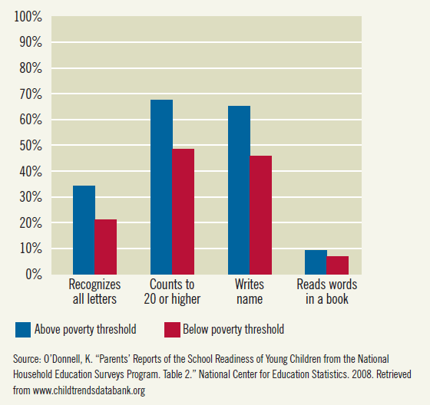
School Readiness
Percent of Children with School Readiness Skills
Notes:
National snapshot that illustrates how poverty effects school readiness
On average, when kids enter kindergarten . On average, lower income children start kindergarten already behind. The achievement gap is there before school even starts.
Later on we will see how this gap plays out as children age and move through the pipeline, thus highlighting the importance of early learning.

Slide 12
The Great Equalizer
*Source: Governor’s Office of Student Achievement: How Do Students’ 3rd Grade Reading Levels Relate to their ACT/SAT and Chance of Graduating from HS?

Slide 13
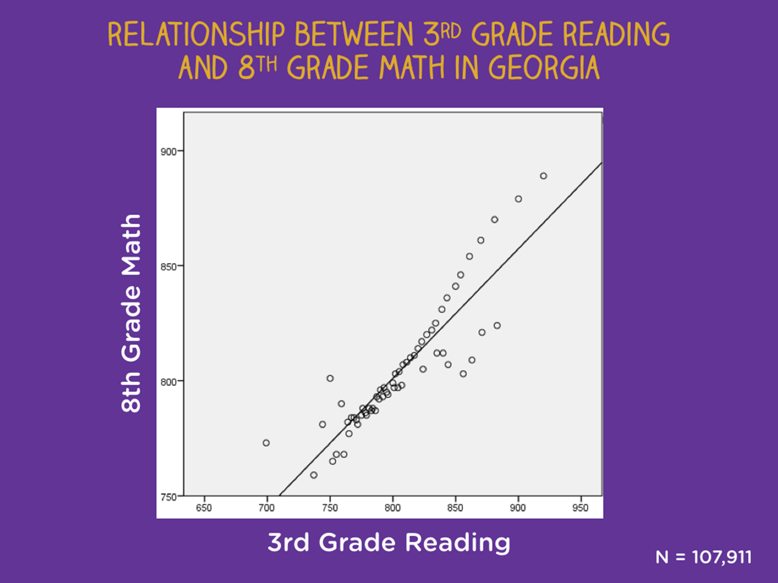

Slide 14
Georgia’s Economic Development Needs
Replacement
1,151,228
TOP GROWING INDUSTRY SECTORS
2015-2025 PROJECTIONS
4,956,144
Georgia is experiencing a talent gap. This talent gap is a mismatch between degrees and skills needed by employers versus the degrees and skills of the population.
Source: Compiled by Georgia Chamber of Commerce 2030, JobsEQ Analysis

Slide 15
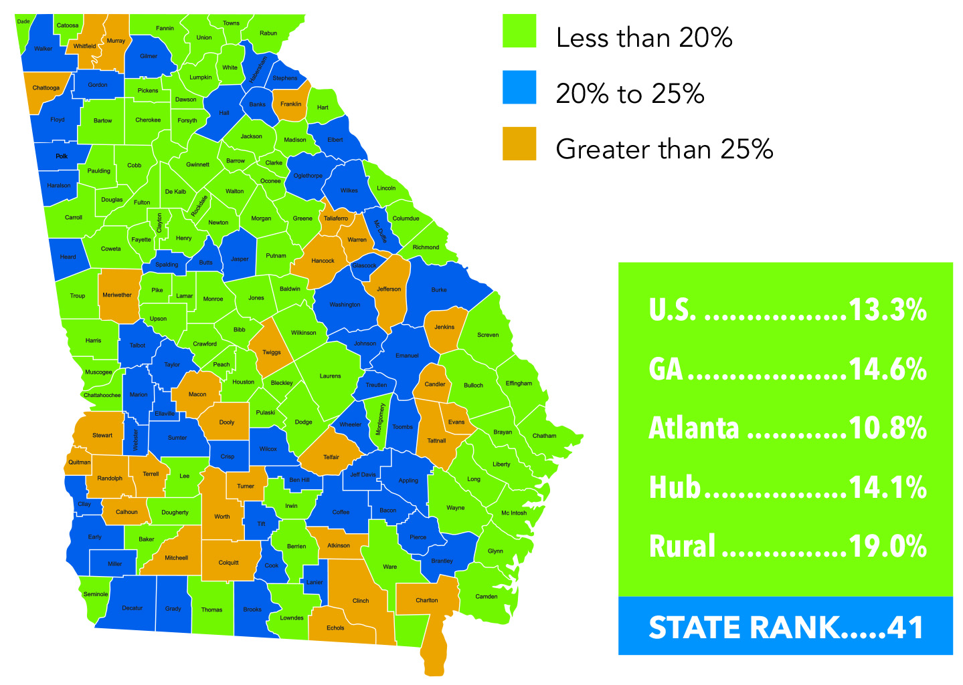
Barriers to Economic Growth:
Adults Without A High School Diploma
Compiled by Georgia Chamber of Commerce 2030, ACS 2015 5-Year estimates

Slide 16
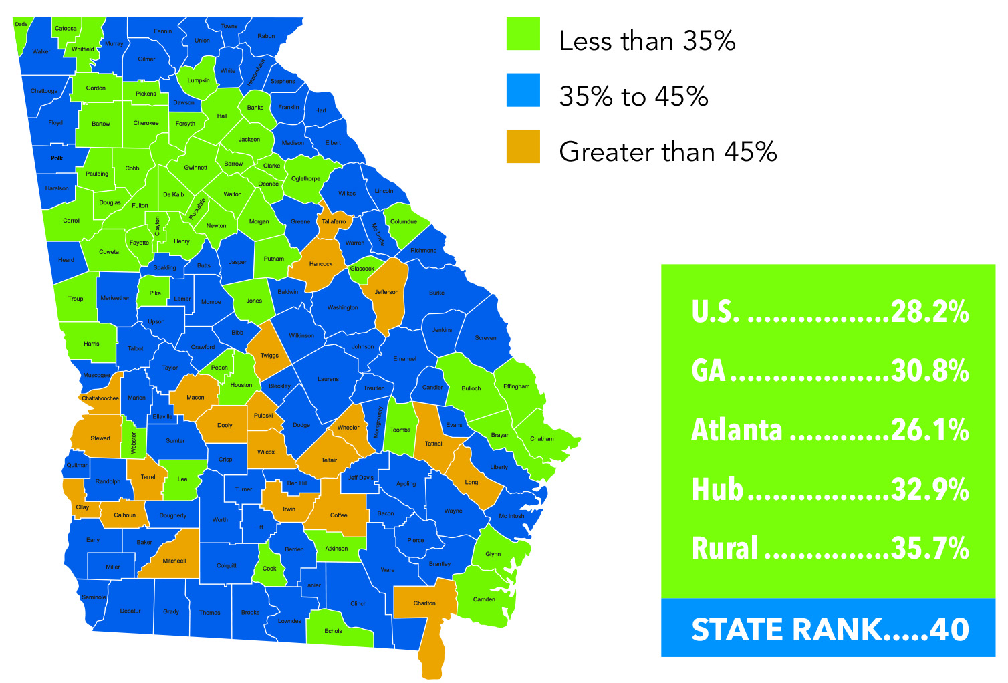
Barriers to Economic Growth:
Adults Not Working, Ages 25-64
Compiled by Georgia Chamber of Commerce 2030, ACS 2015 5-Year estimates
Notes:
Challenge for communities – how to do you re-enegage the adult population in the workforce. Why are they out of it? Job training? Literacy? Education levels?

Slide 17
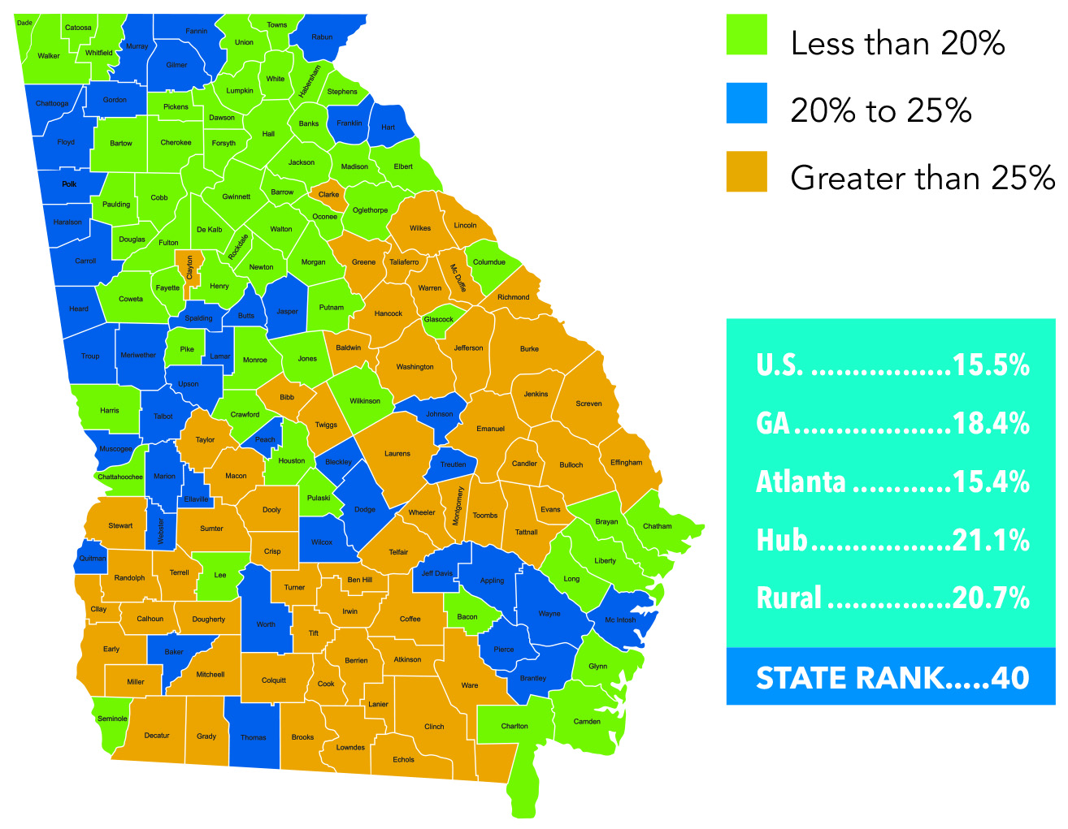
Barriers to Economic Growth: Poverty Rates
ACS 2015 5-year estimates/Kids Counts Data Center
Notes:
Calculations done by the Georgia Chamber of Commerce
Adult population
59 of Georgia’s 159 counties have greater than 25% poverty
Lowest Poverty Rate – Forsyth and Oconee (7%)
Highest Poverty Rate – Calhoun and Clay – 42% of the residents are below the official poverty threshold

Slide 18
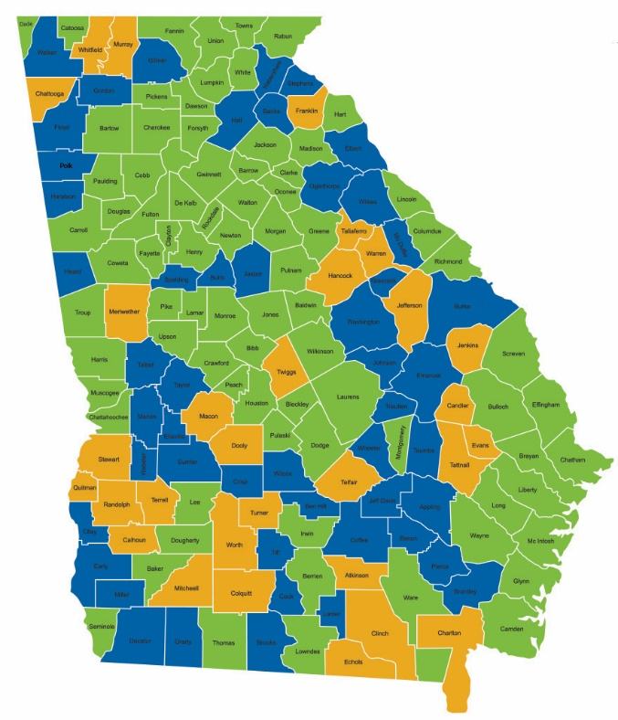
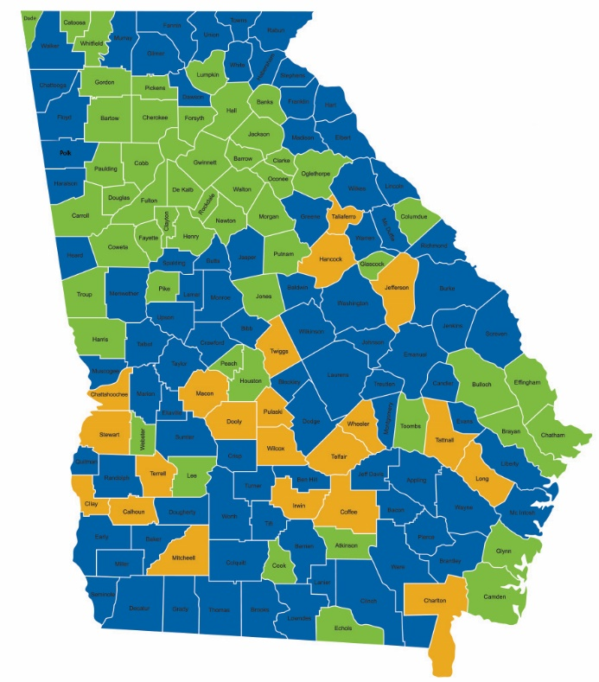
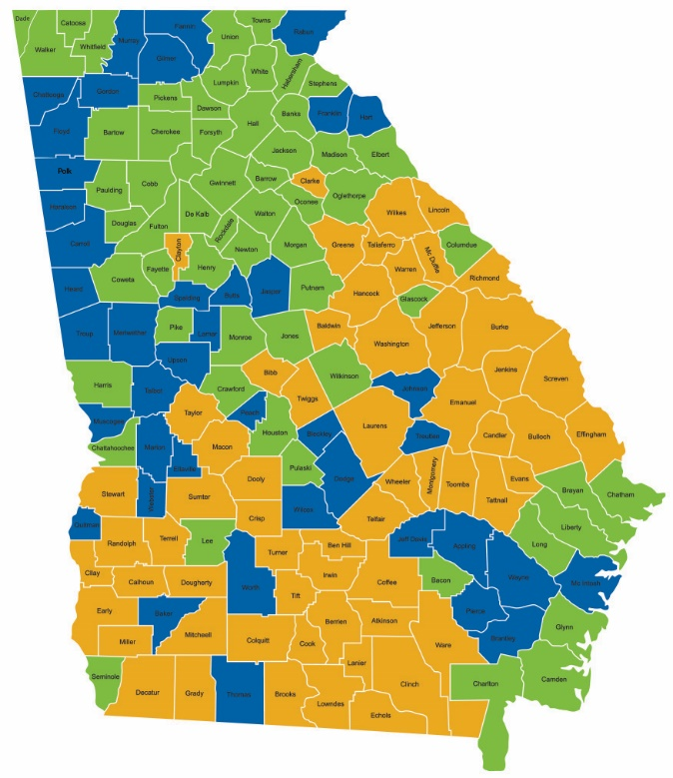
Barriers to Economic Growth
No HS Diploma
Adults Not Working
Poverty
Notes:
Doug Betchel – UGA professor – started with the 2 Georgia’s. Before he passed away, he updated that to the 5 Georgia’s: Urban, Urbanizing, Suburban, Rural Growth, Rural Decline
Rest of the state is important. Statewide agencies, statewide presence. Also, Atlanta can’t continue to support the rest of the state.

Slide 19
Compounded Impacts of
High School Non-Completion
INDIVIDUALS |  | THE COMMUNITY
Lower Lifetime Earnings |  | Reduced buying power & tax revenues; less economic growth
Decreased health status; Higher mortality rates; More criminal activity |  | Higher health care & criminal justice costs
Higher teen pregnancy rates; Single motherhood |  | Higher public services costs
Less voting; Less volunteering |  | Low rate of community involvement
Source: Levin, H., et al., (2007). The Costs and Benefits of an Excellent Education for All of America’s Children.
Notes:
Roll those dollars up and what happens to the individual and to the community.
Lower Lifetime Earnings – can mean a difference of ½ million dollars or more for the individual
Reduced Buying Power – businesses are concerned about this. Think of what it could also man in reduced tax revenues. School systems use the SPLOST to renovate and build schools
Decreased Health Status…-- Raises many health issues
Higher Health Care…-80% of folks in prison don’t have a HS diploma; contributes to increased cost
Higher Teen Pregnancy Rates…- How many 15 – 19 year olds in your community have their 1st baby or even their 2nd baby? Realizing that a mother is a child’s first teacher, they are not always the best teacher, especially when a young teenage mother. Again, you will see some of those numbers in the KidsCount data we will share
Higher Public Service Costs –
Less Voting and Volunteering –
Less Community Involvement – This impacts the infrastructure of a community
Community involvement- for economic development – need community engagement and civic involvement.
Transition to next slide – so we see what this looks like for an individual and how that translates to impacts on a community. Next, I want to look at the economic impact (dollar amount) on the state.

Slide 20
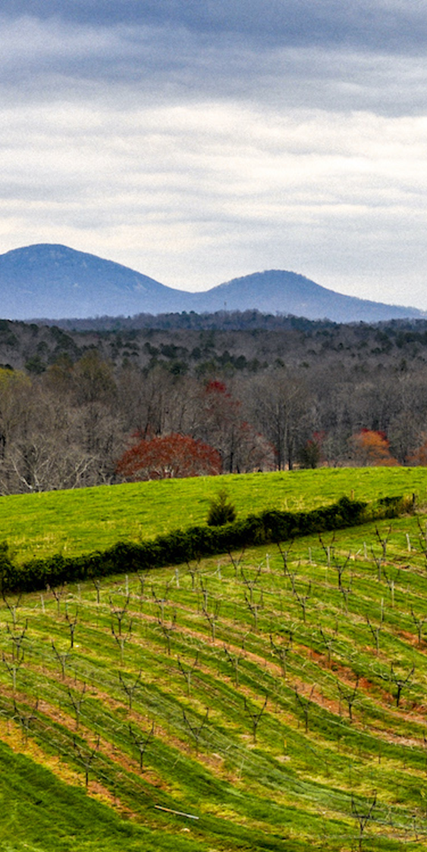
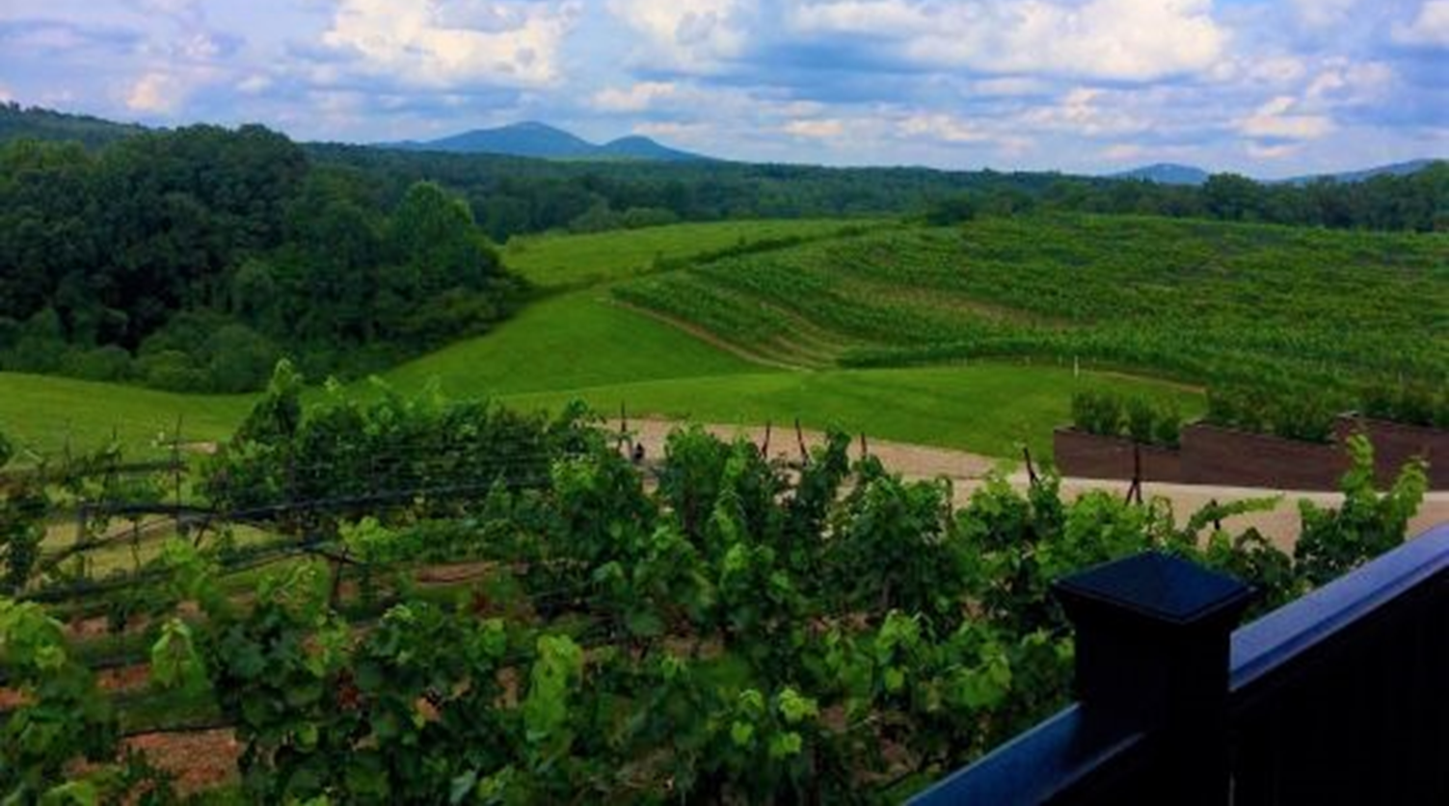
So how do we cultivate our talent?

Slide 21
Percent Low-Income by School District
Source: The Governor’s Office of Student Achievement, State Report Cards, % Eligible for Free/ Reduced Meals 2018

Slide 22
Percent Low-Income and
Proficient + Distinguished 3rd Grade English Language Arts
Source: The Governor’s Office of Student Achievement, State Report Cards. Georgia Milestones 2018

Slide 23
Profile of Child Wellbeing and Academic Achievement
Source: Georgia Kids Count, Georgia Family Connection Partnership, http://www.gafcp.org
Notes:
Pasta slides – look at some of these factors that could cause a crack in your pipeline.
Throw these data up – look for county and see how you are doing.

Slide 24
Babies Born to Mothers with
<12 Years of Education
Source: Georgia Kids Count, Georgia Family Connection Partnership, http://www.gafcp.org
Notes:
Point out Ga
What’s the difference between these counties?

Slide 25
Percent Teens Not Working or in School
Source: Georgia Kids Count, Georgia Family Connection Partnership, http://www.gafcp.org
Notes:
Point out Ga
After recession

Slide 26
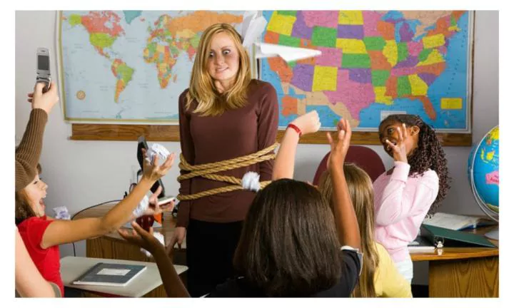
But wait, I’m not a teacher!

Slide 27
Join, support, and amplify a literacy campaign
Get Georgia Reading
Department of Early Childcare and Learning (DECAL)
Bright from the Start
Ferst Readers and other nonprofits
Department of Public Health
Community campaigns and collaborations

Slide 28
Educate your employees about early literacy
Educate
Educate employees through posters, announcements, training
Connect
Connect parents with resources (Ferst Readers, Dolly Parton’s Imagination Library)
Encourage
Encourage participation with literacy efforts
Support
Support quality day care and early learning.
Little Libraries, Adopt a Classroom, etc.

Slide 29
Aligning Educational Strategies for
Collective Impact
Random Acts of Improvement
GOALS
Partially Aligned Acts of Improvement
GOALS
Aligned Acts of Improvement
GOALS
Notes:
If your efforts are not aligned, whether in business or schools, it’s going to be harder to stay focused and reach your goal. How many of your schools have random acts that compete against each other?
If we are all aimed in the same direction with focus on the same goal, it can be reached. In business, that goal is profits; in education, that goal is student achievement.
Slide transition statement – Now, we want to take some time for you all to reflect on how to align your acts of improvement around your goals.

Slide 30

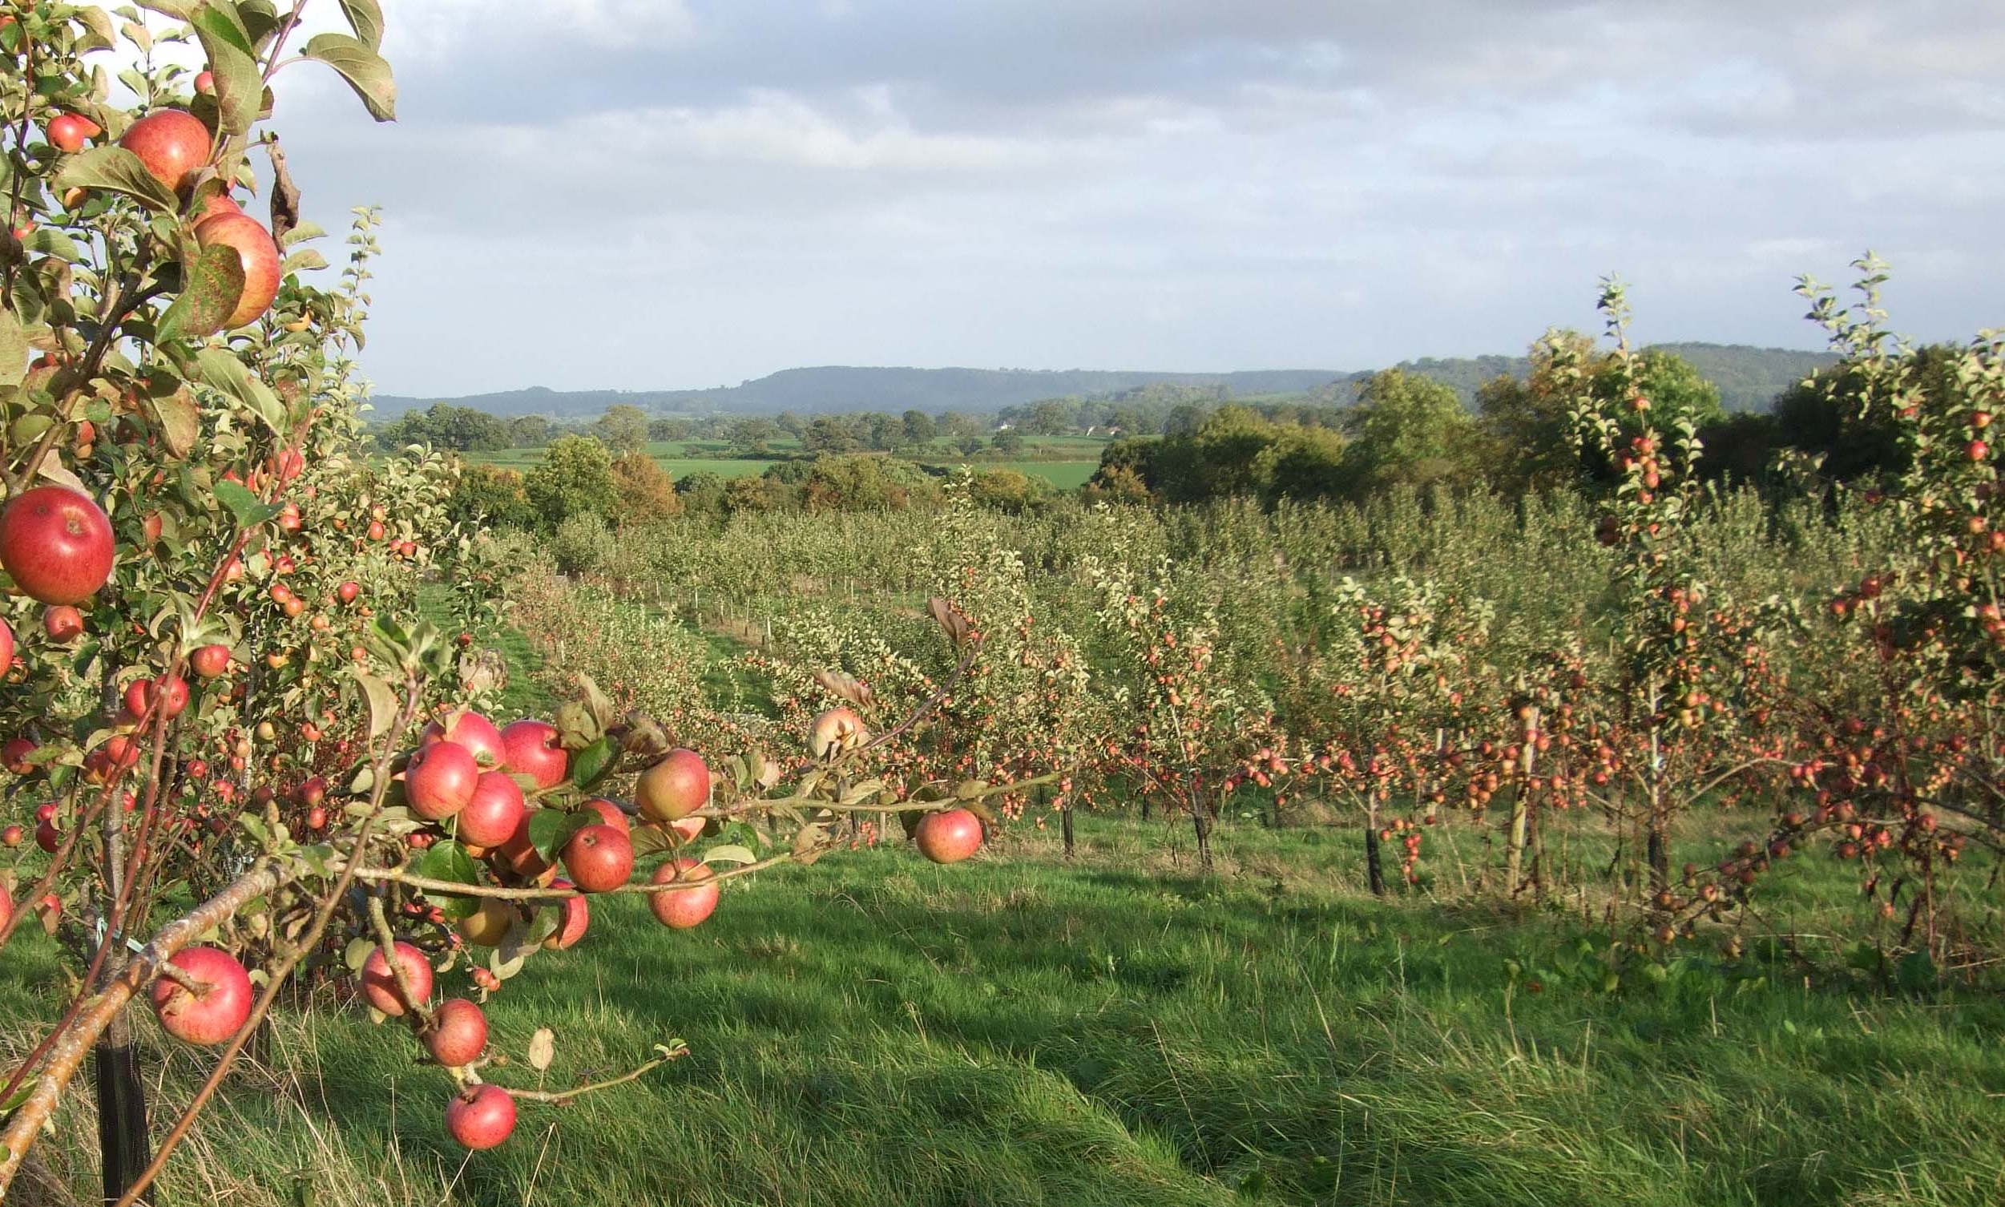
Cultivating your
Workforce Pipeline
Connect with us
Email: mwilcox@gpee.org
Twitter: @GAPartnership
Instagram: @GAPARTNERSHIP
Facebook: Georgia Partnership for Excellence in Education
LinkedIn: Georgia Partnership for Excellence in Education
Website: www.gpee.org
Rural Prosperity Forum
North Georgia
Georgia Chamber of Commerce

