Slide 1
Reflections from a Teacher
2024 GaTOTY Christy Todd
January 5, 2024

Slide 2
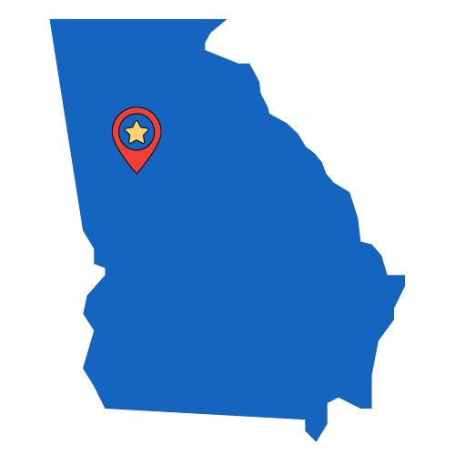
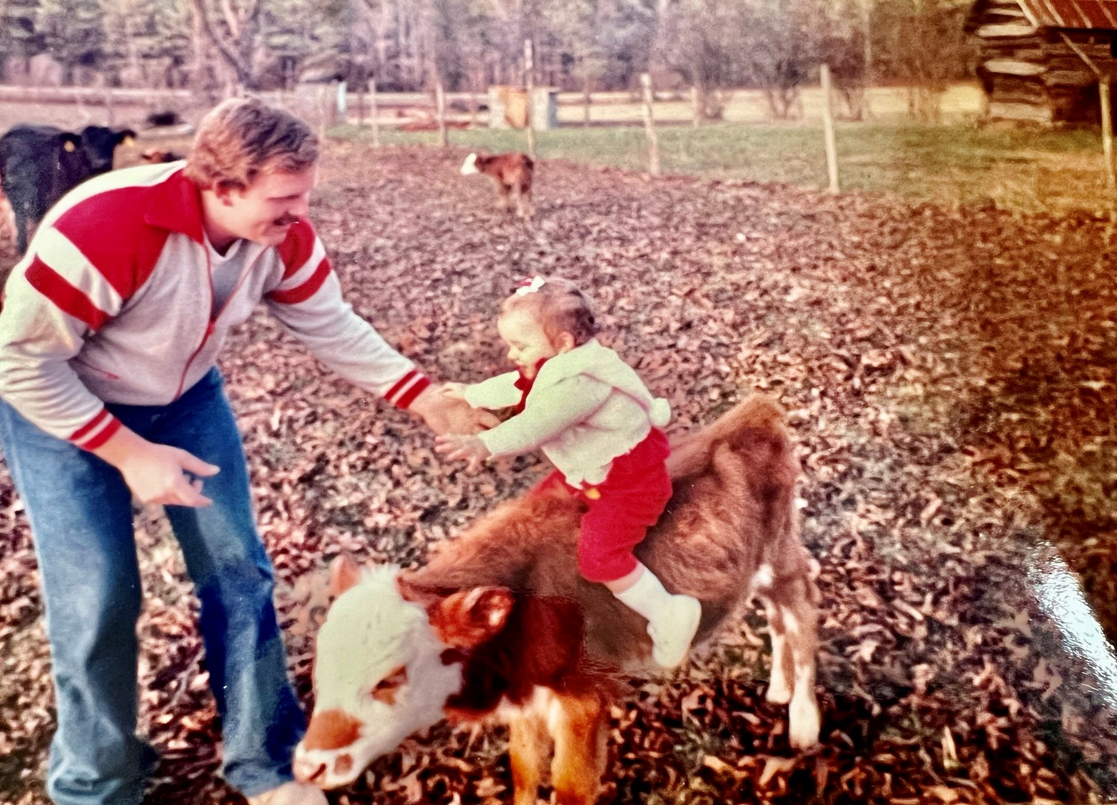

Slide 3
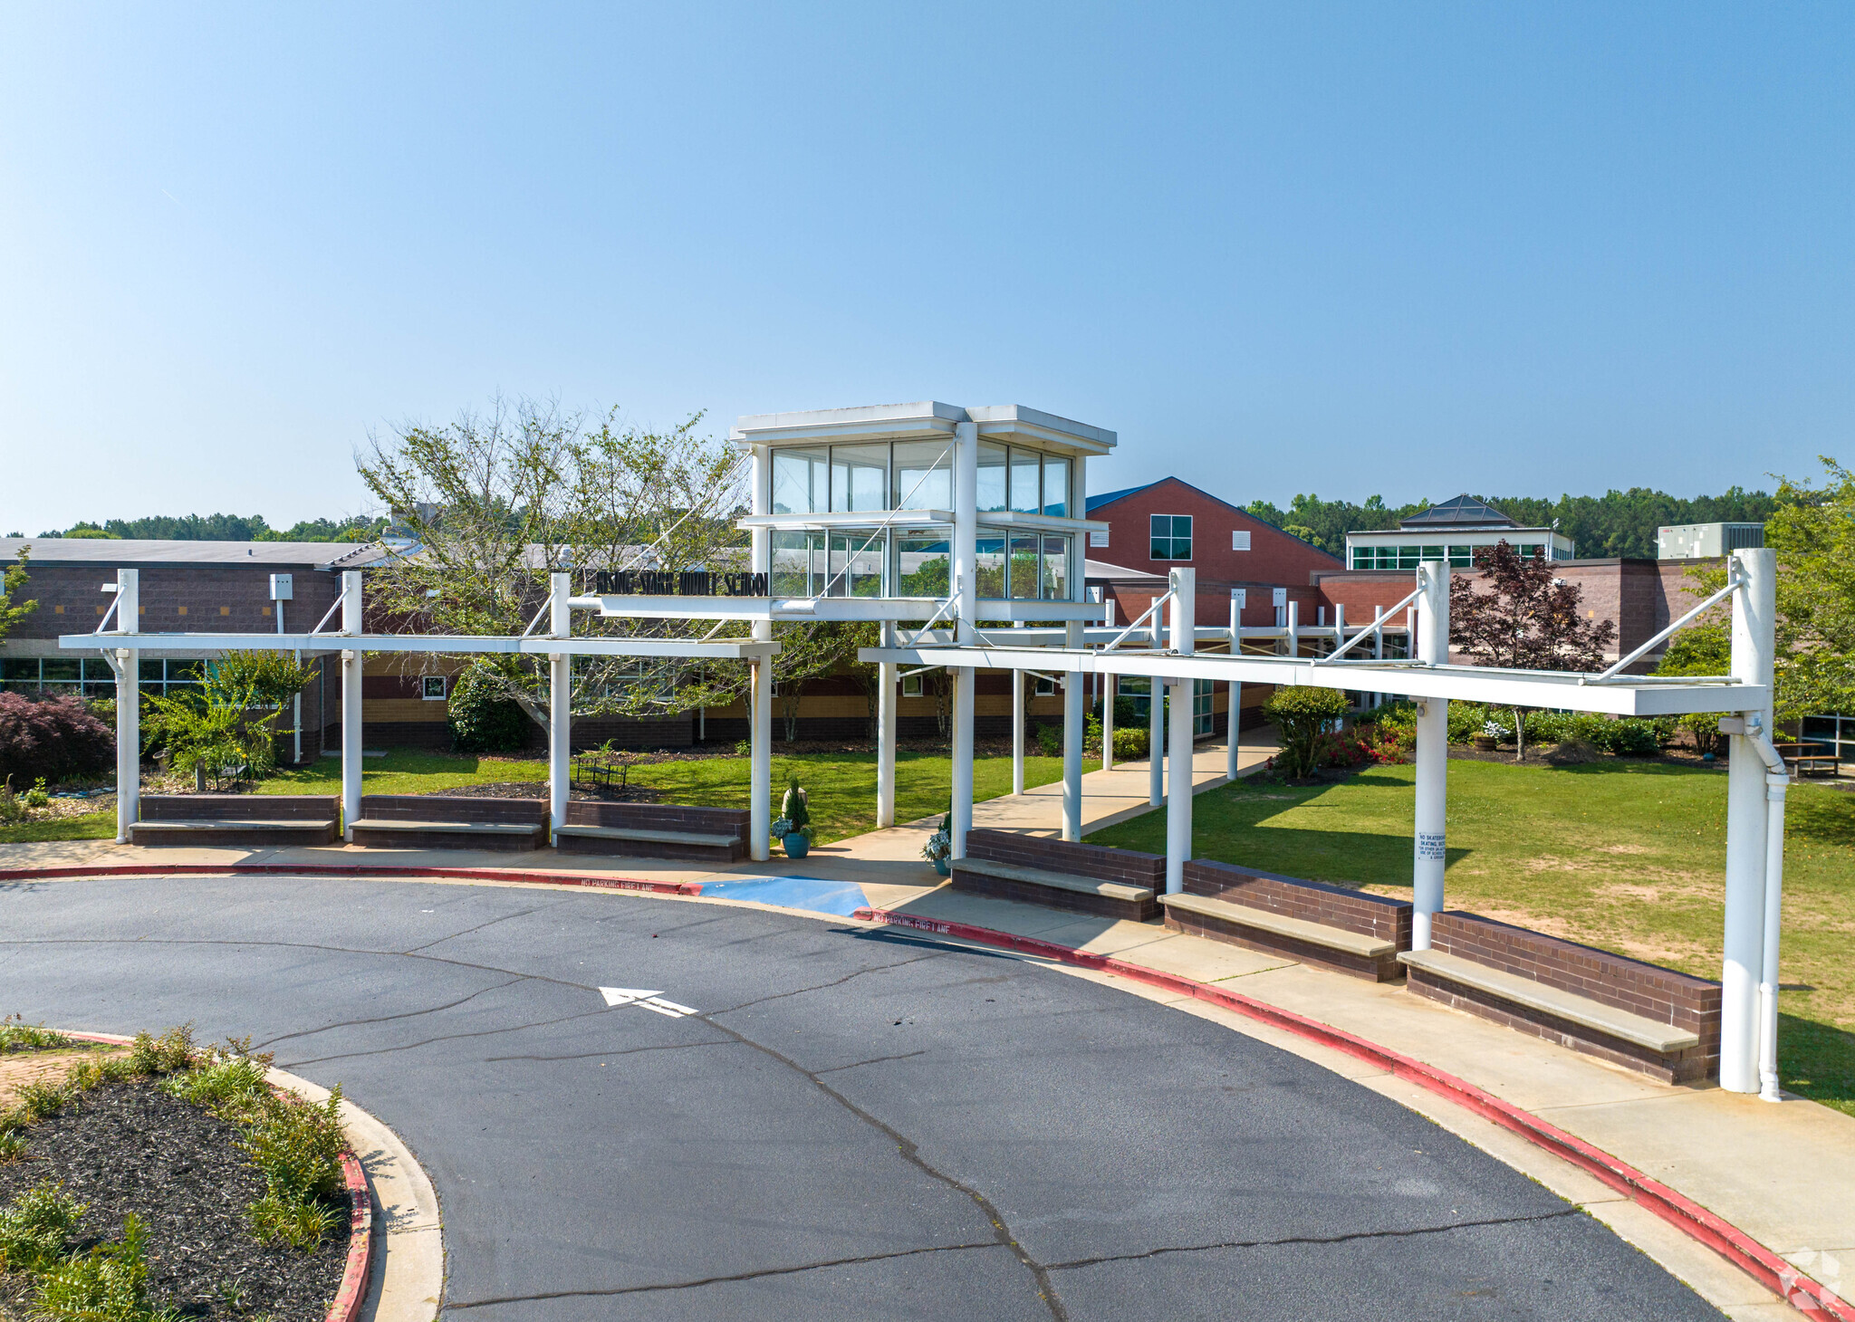
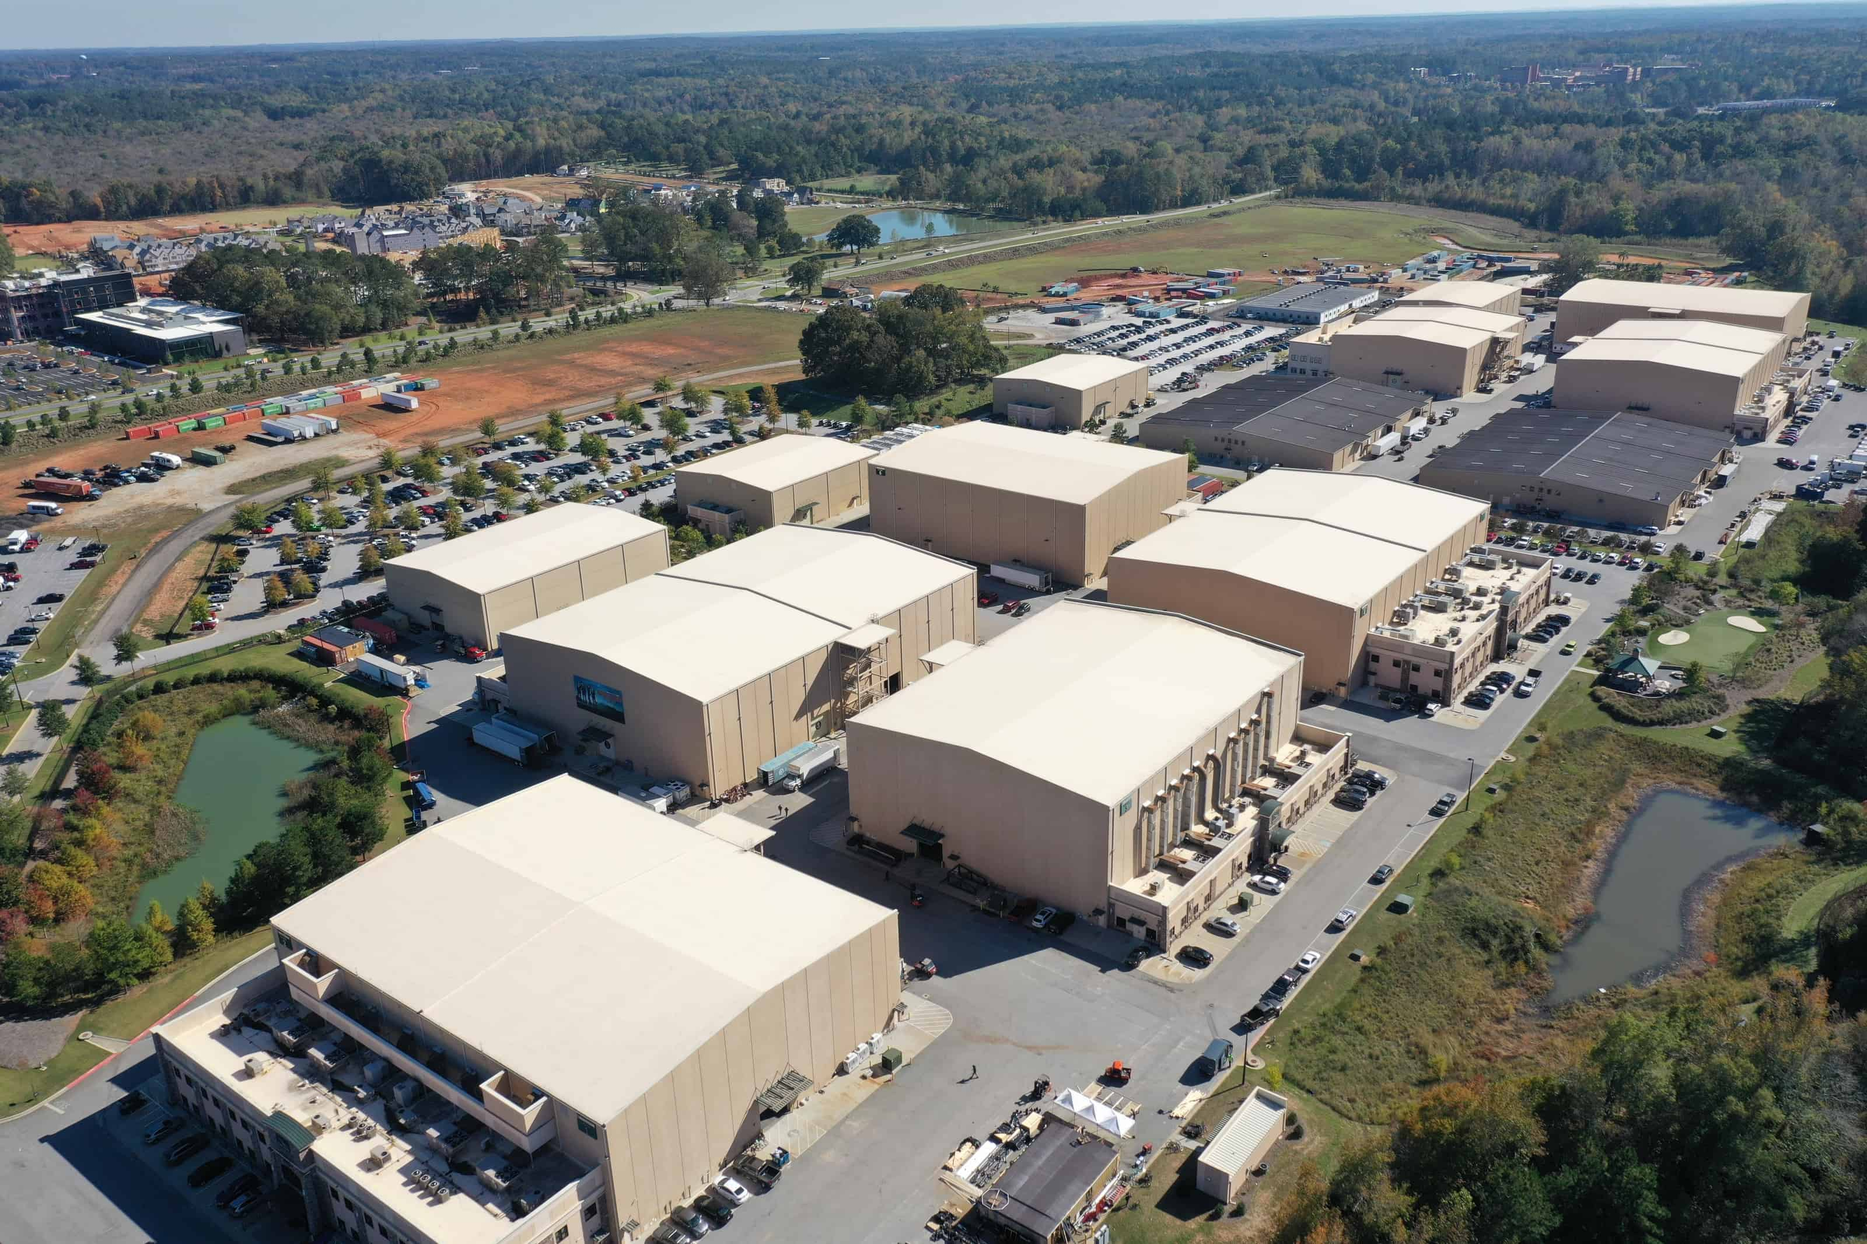

Slide 4
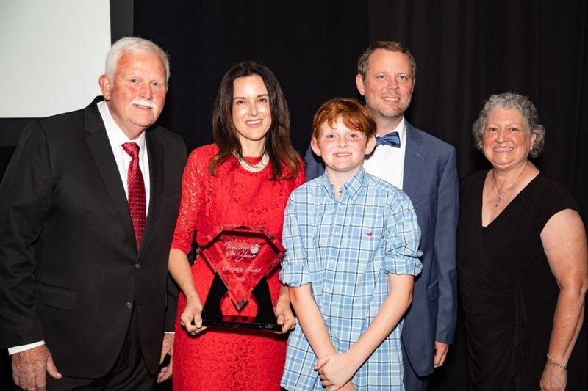

Slide 5
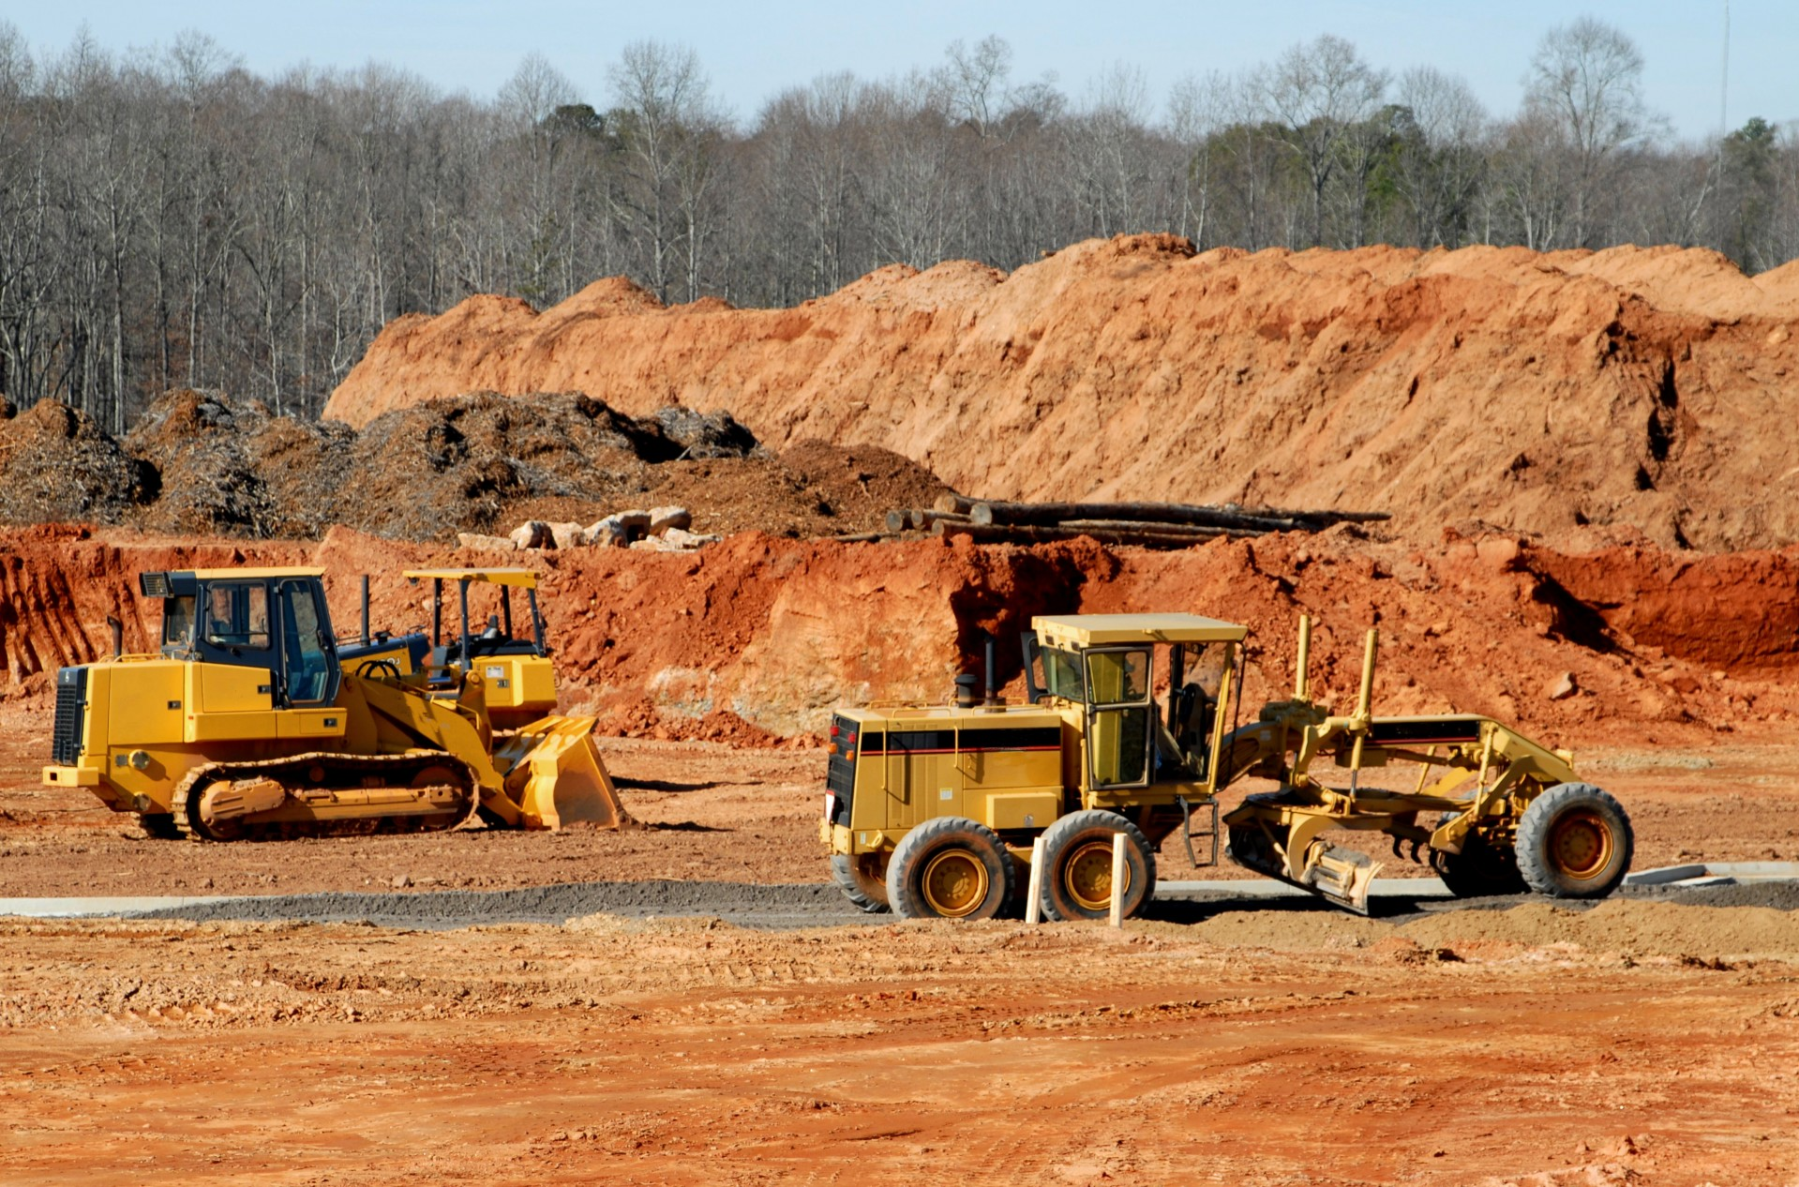

Slide 7
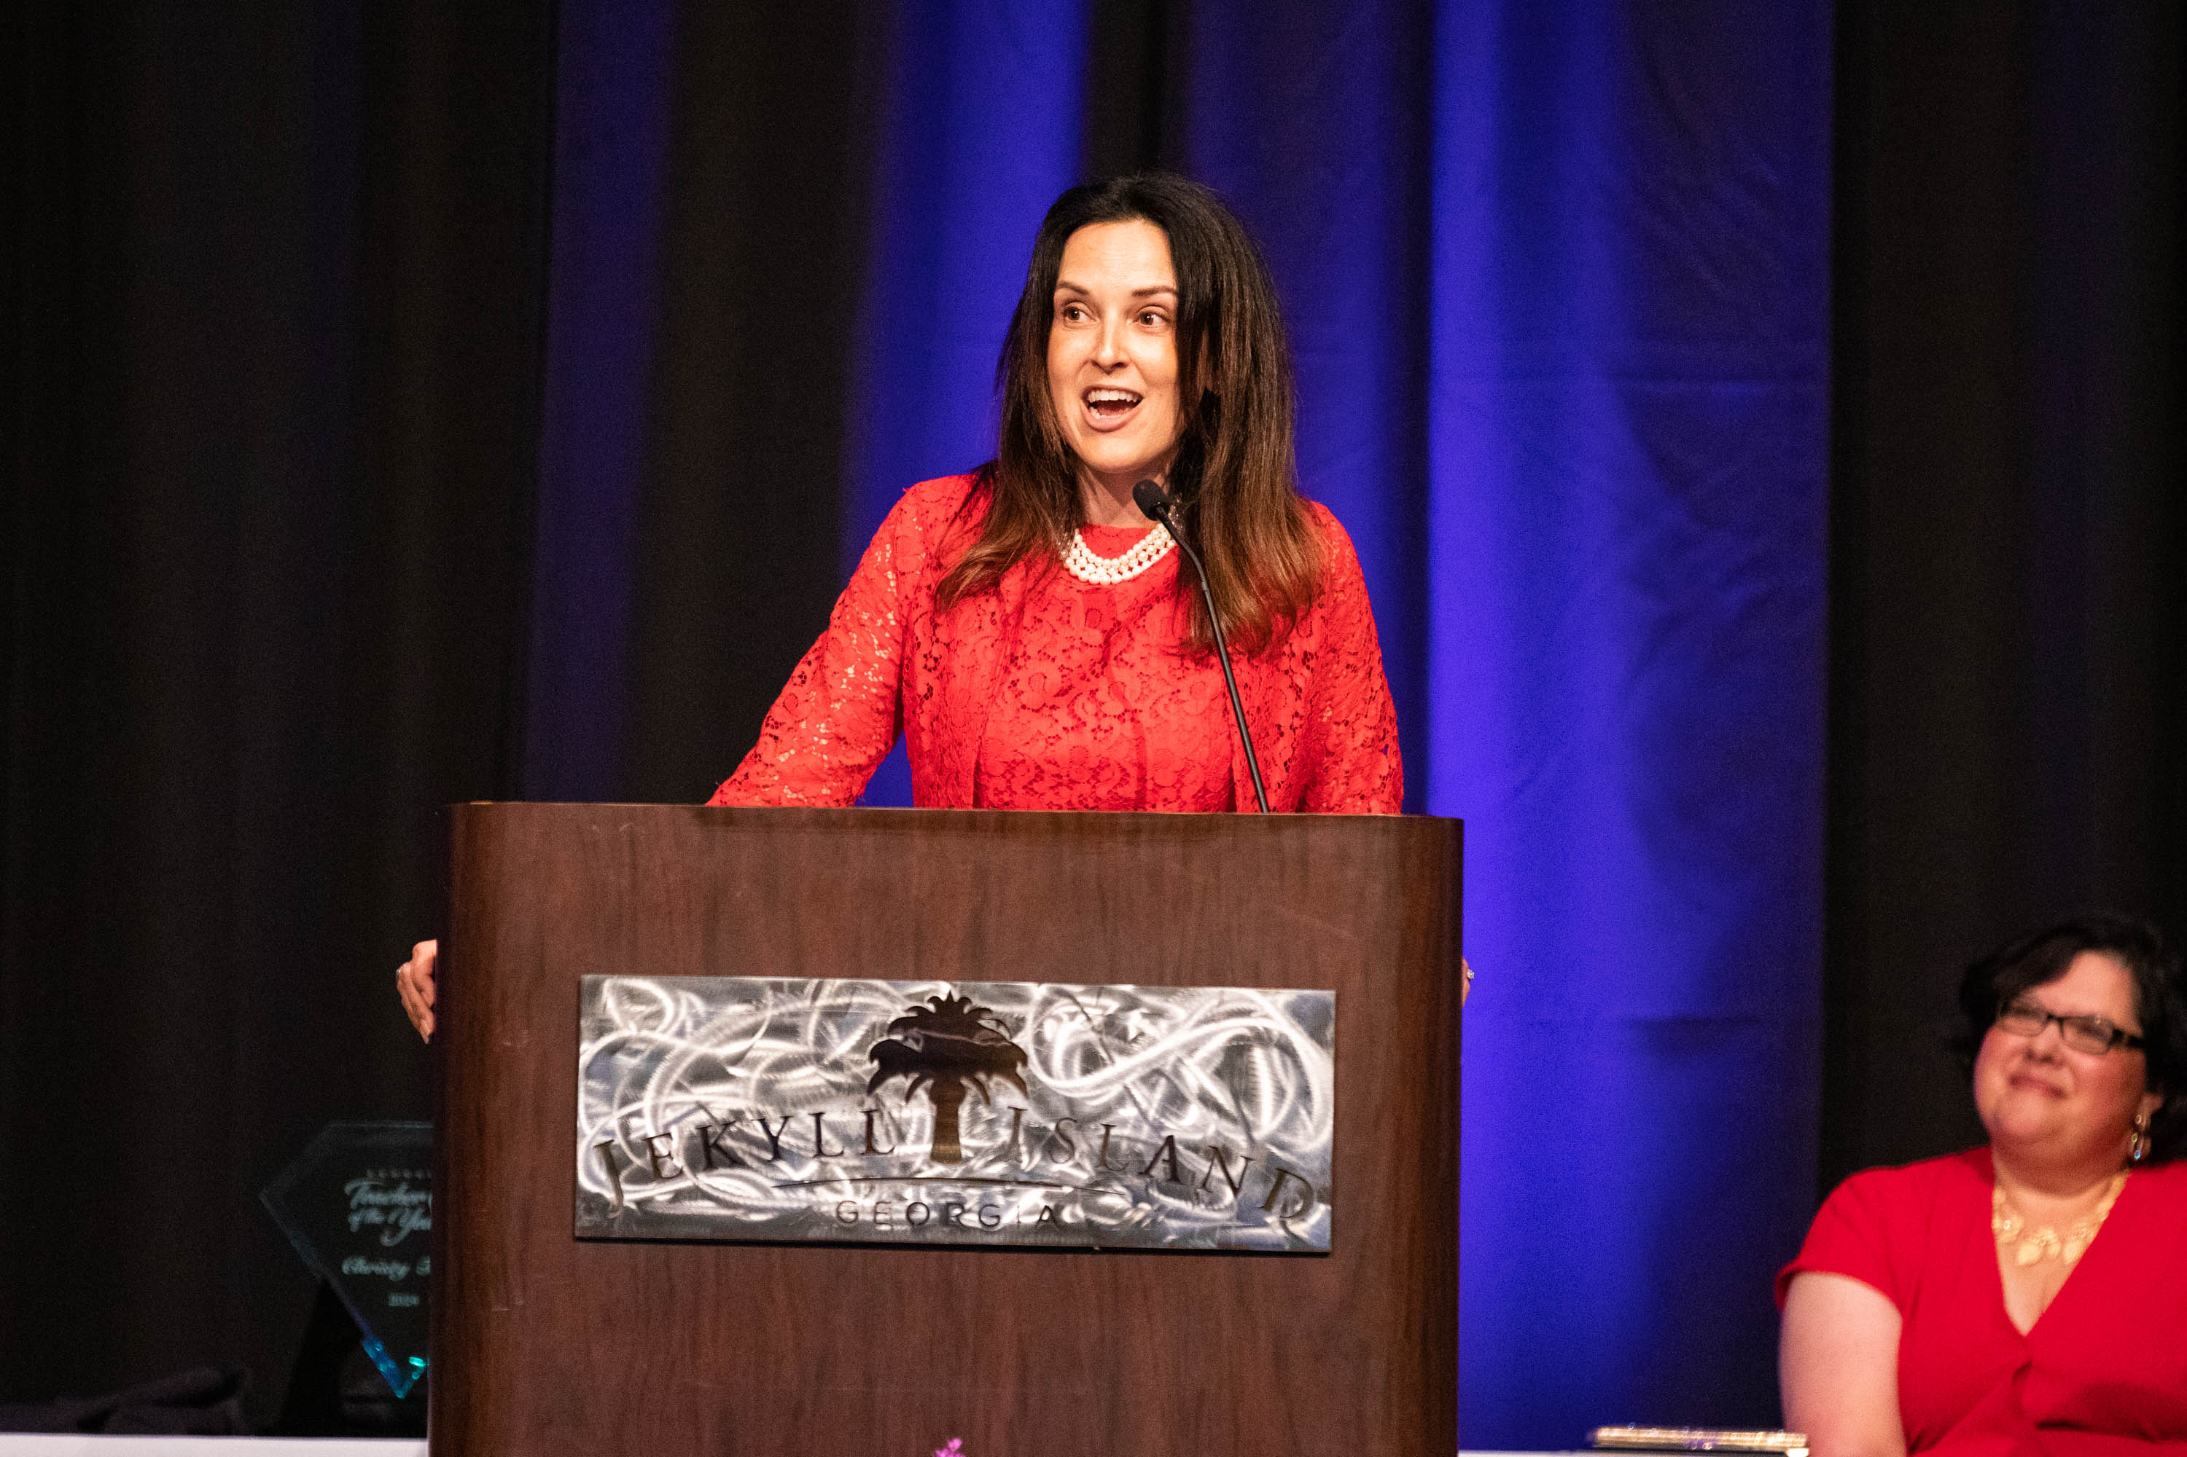

Slide 8
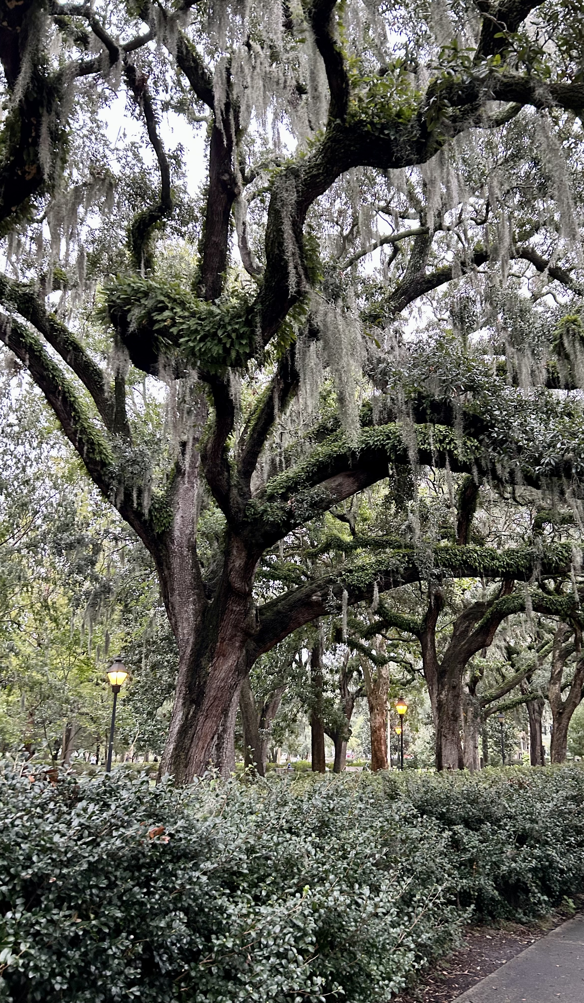
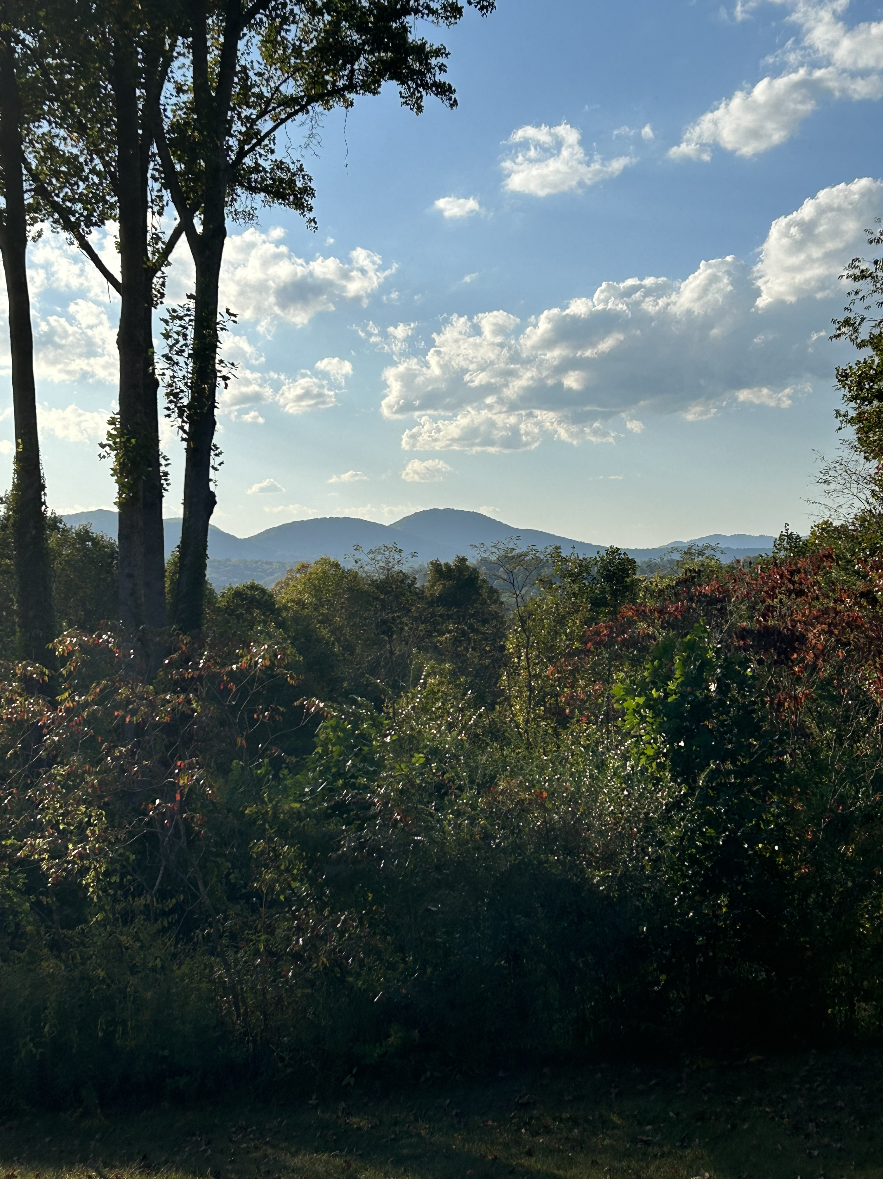
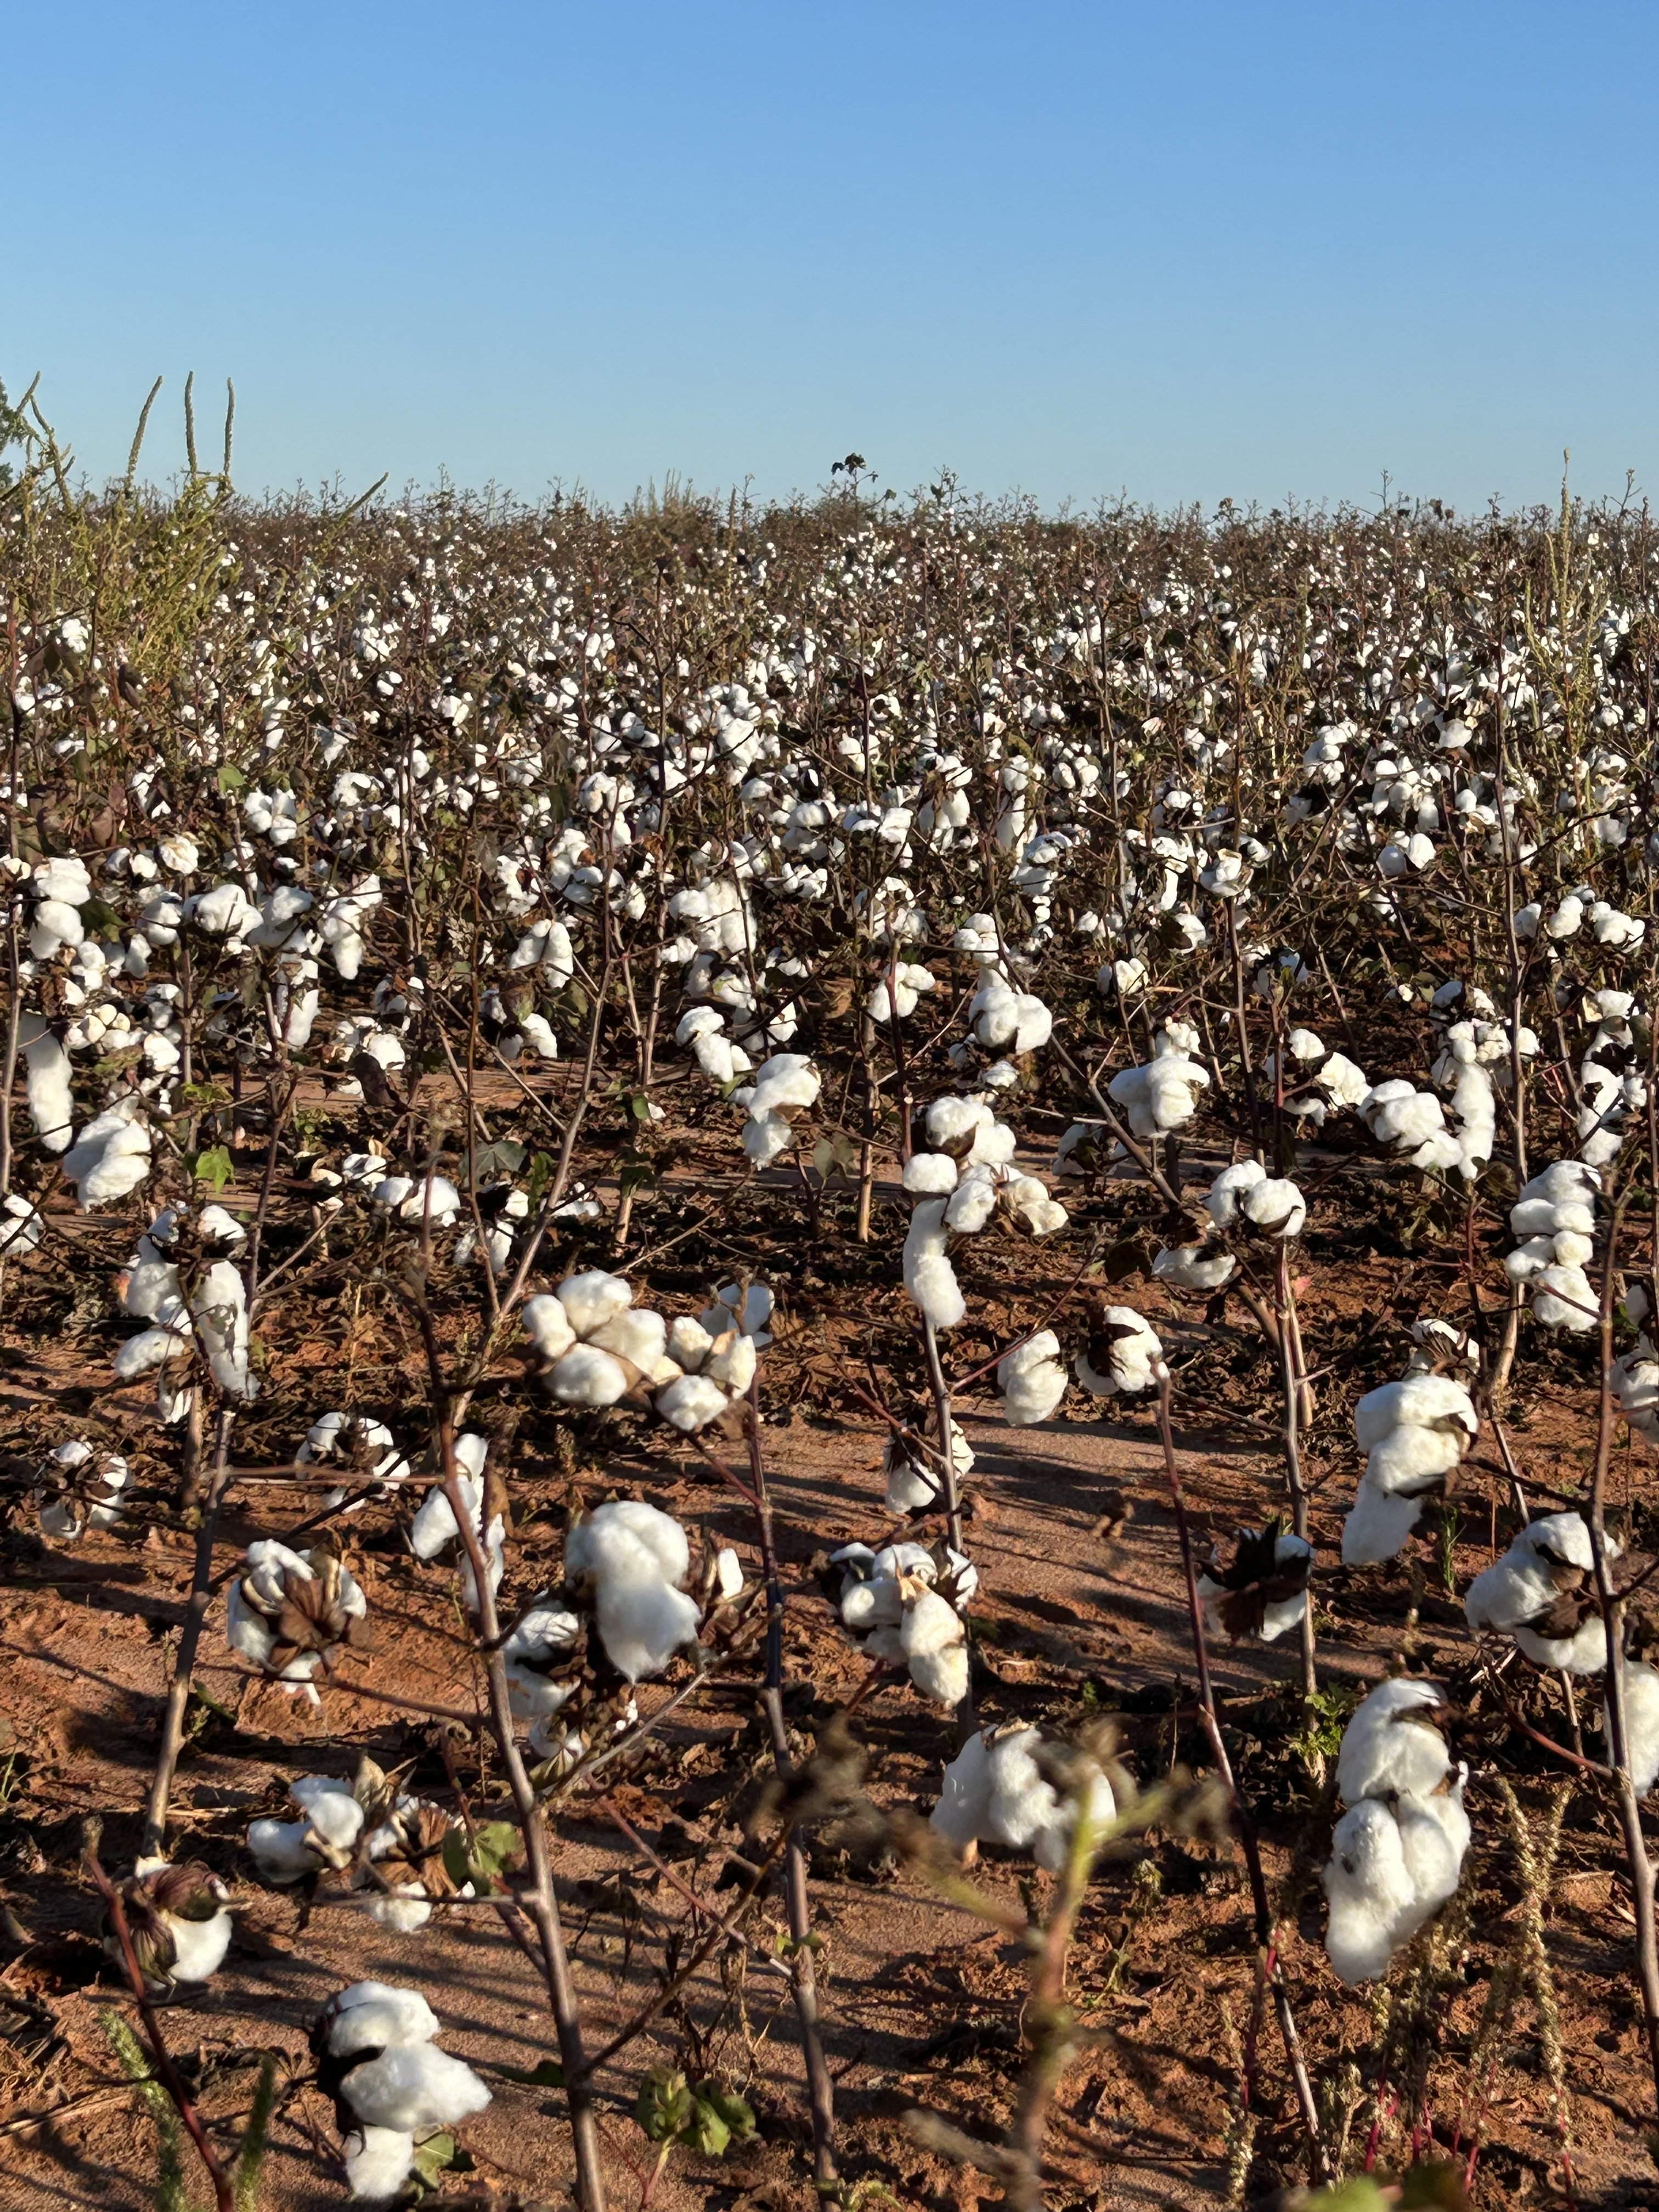

Slide 10
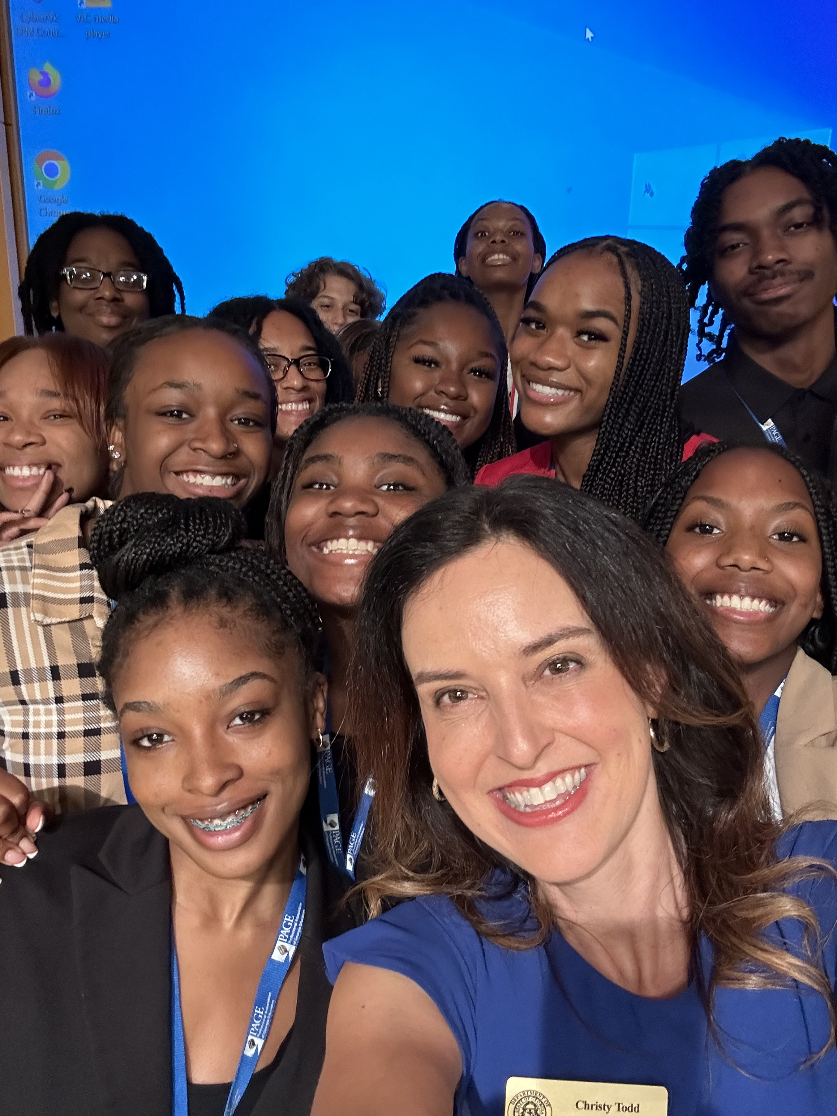

Slide 11
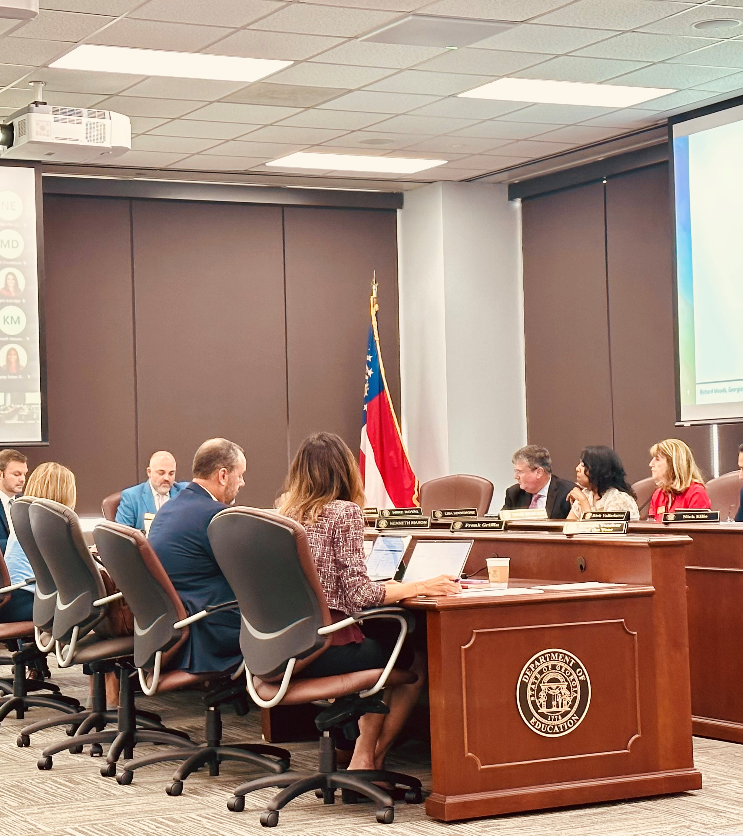

Slide 14
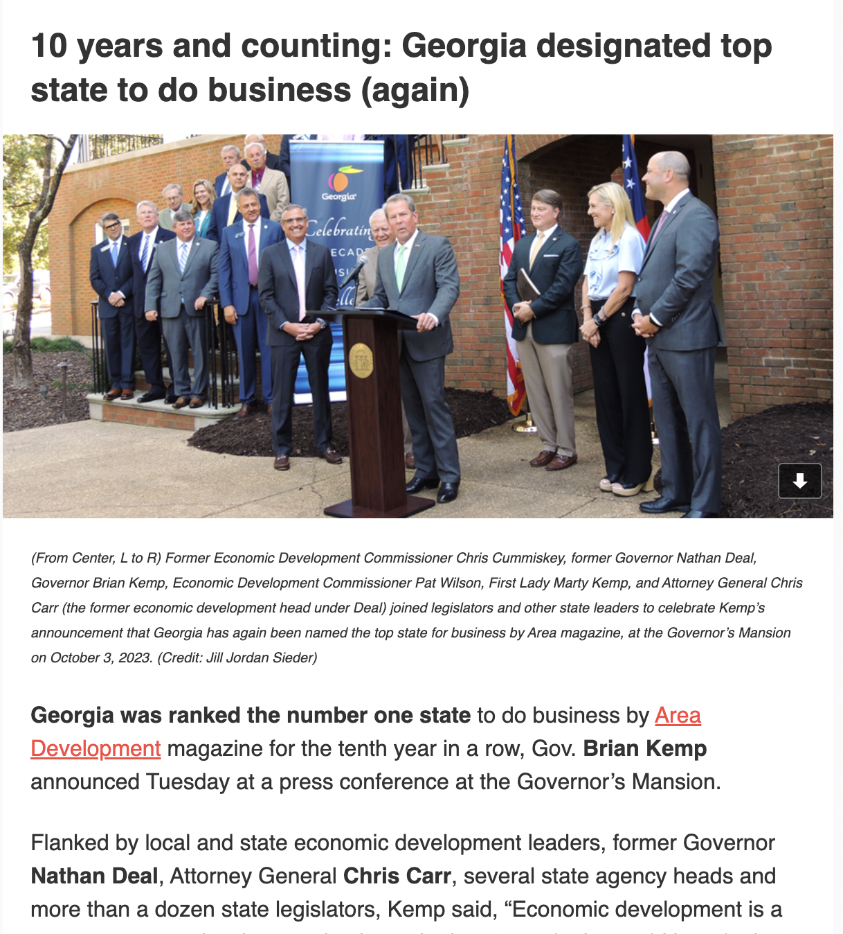

Slide 15
The Photo by PhotoAuthor is licensed under CCYYSA.

Slide 17
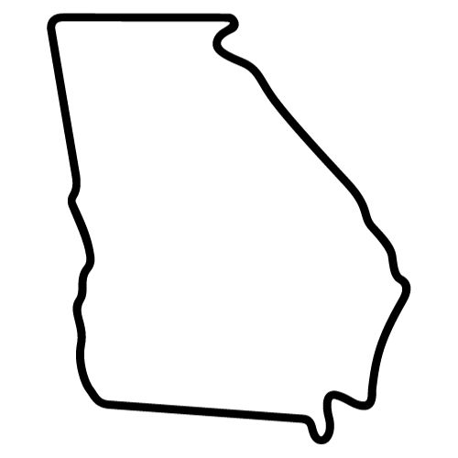
If new business comes to Georgia,
then you’ll need new employees you can hire.

Slide 18
people will first need an excellent education.
If you need new employees you can hire,

Slide 19
If people need an excellent education,
they must have excellent teachers.

Slide 20
If you need excellent teachers,

Slide 21
You need to make Georgia the
#1 State for Teachers to Work.

Slide 22
THE END

Slide 23
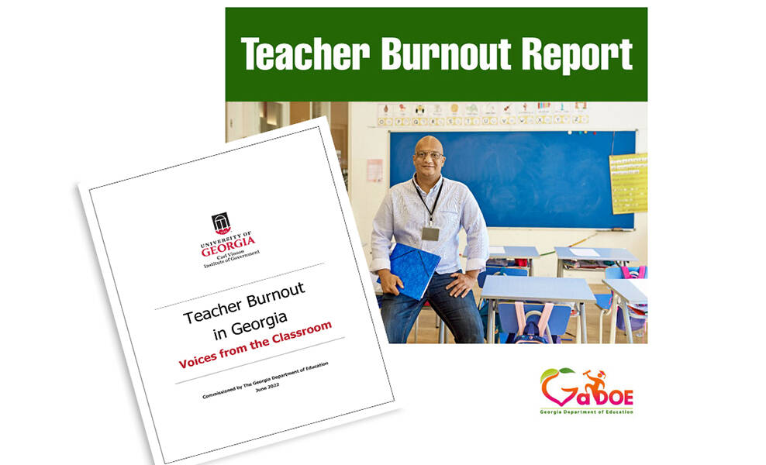
Positive Progress

Slide 24
Positive Progress
Teacher pay raise of $7,000 over the past 5 years
$2,000 in retention bonuses from COVID funds & state surplus
Free Mental Health Counseling, Financial, and Legal resources through the GA Public Employee Assistance Program
GaLEADS teacher evaluation system (pilot) that provides differentiated feedback & supports based on teacher experience

Slide 25
Positive Progress
Teacher Tax Credits of up to $15,000 over 5 years for new teacher hires working in rural and/or low performing schools
$11 million in state-funded grants for teacher endorsements and GaTAPP scholarships in high-need areas
Option for retired teachers to return to work full time in high-need subject areas while receiving TRS benefits

Slide 26
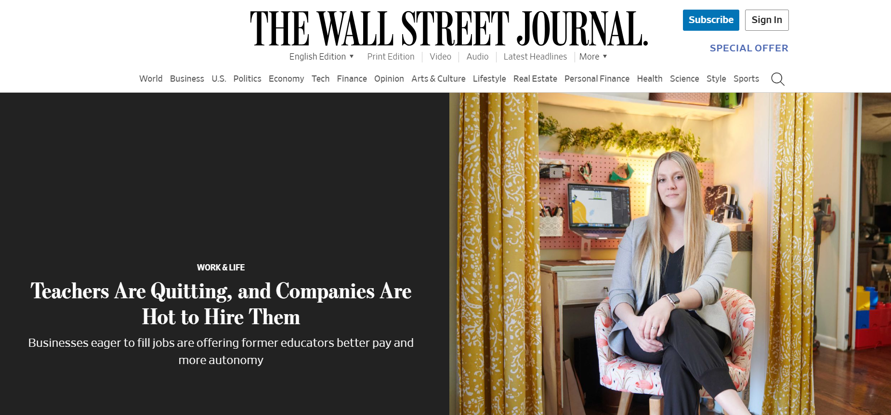

Slide 27
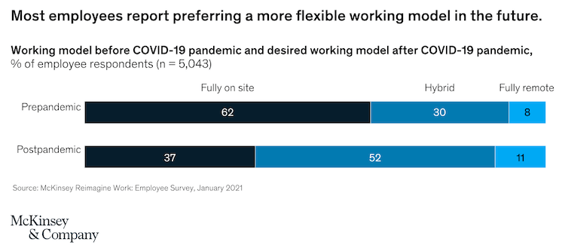

Slide 28
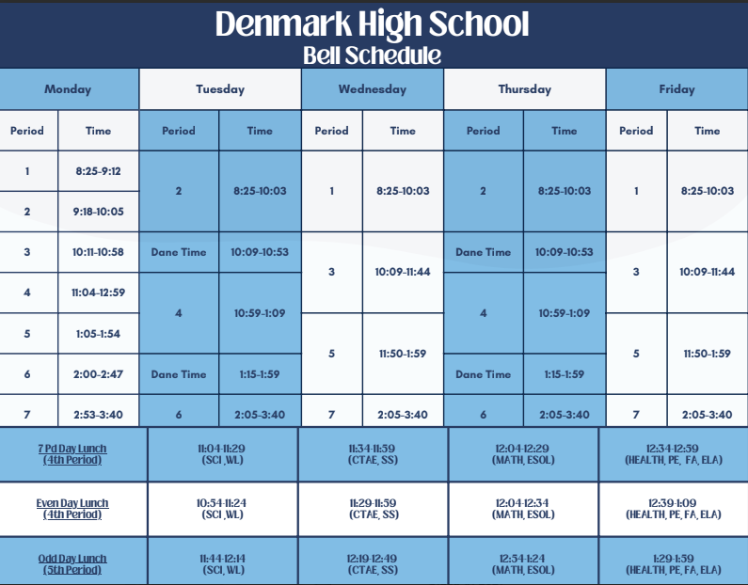

Slide 29
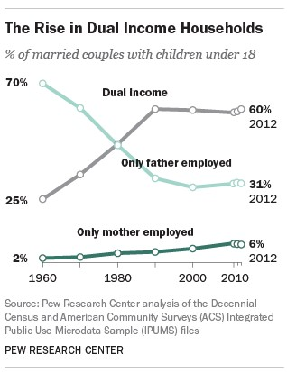

Slide 30
This Photo by Unknown Author is licensed under CC BY-SA

Slide 31
Our Playbook
Increase Compensation, Employment Options & Career Advancement Opportunities
Connect Wrap-Around Services to Students & Staff
Fully Fund Schools

Slide 32
“Reimagining the teaching job requires bold leadership and a willingness to challenge long-held assumptions about how people, time, and money are organized in our schools.” erstrategies.org
What We Need

Slide 33
In Conclusion

Slide 34
Let’s make Georgia…
The #1 State for Teachers to Work

Slide 35
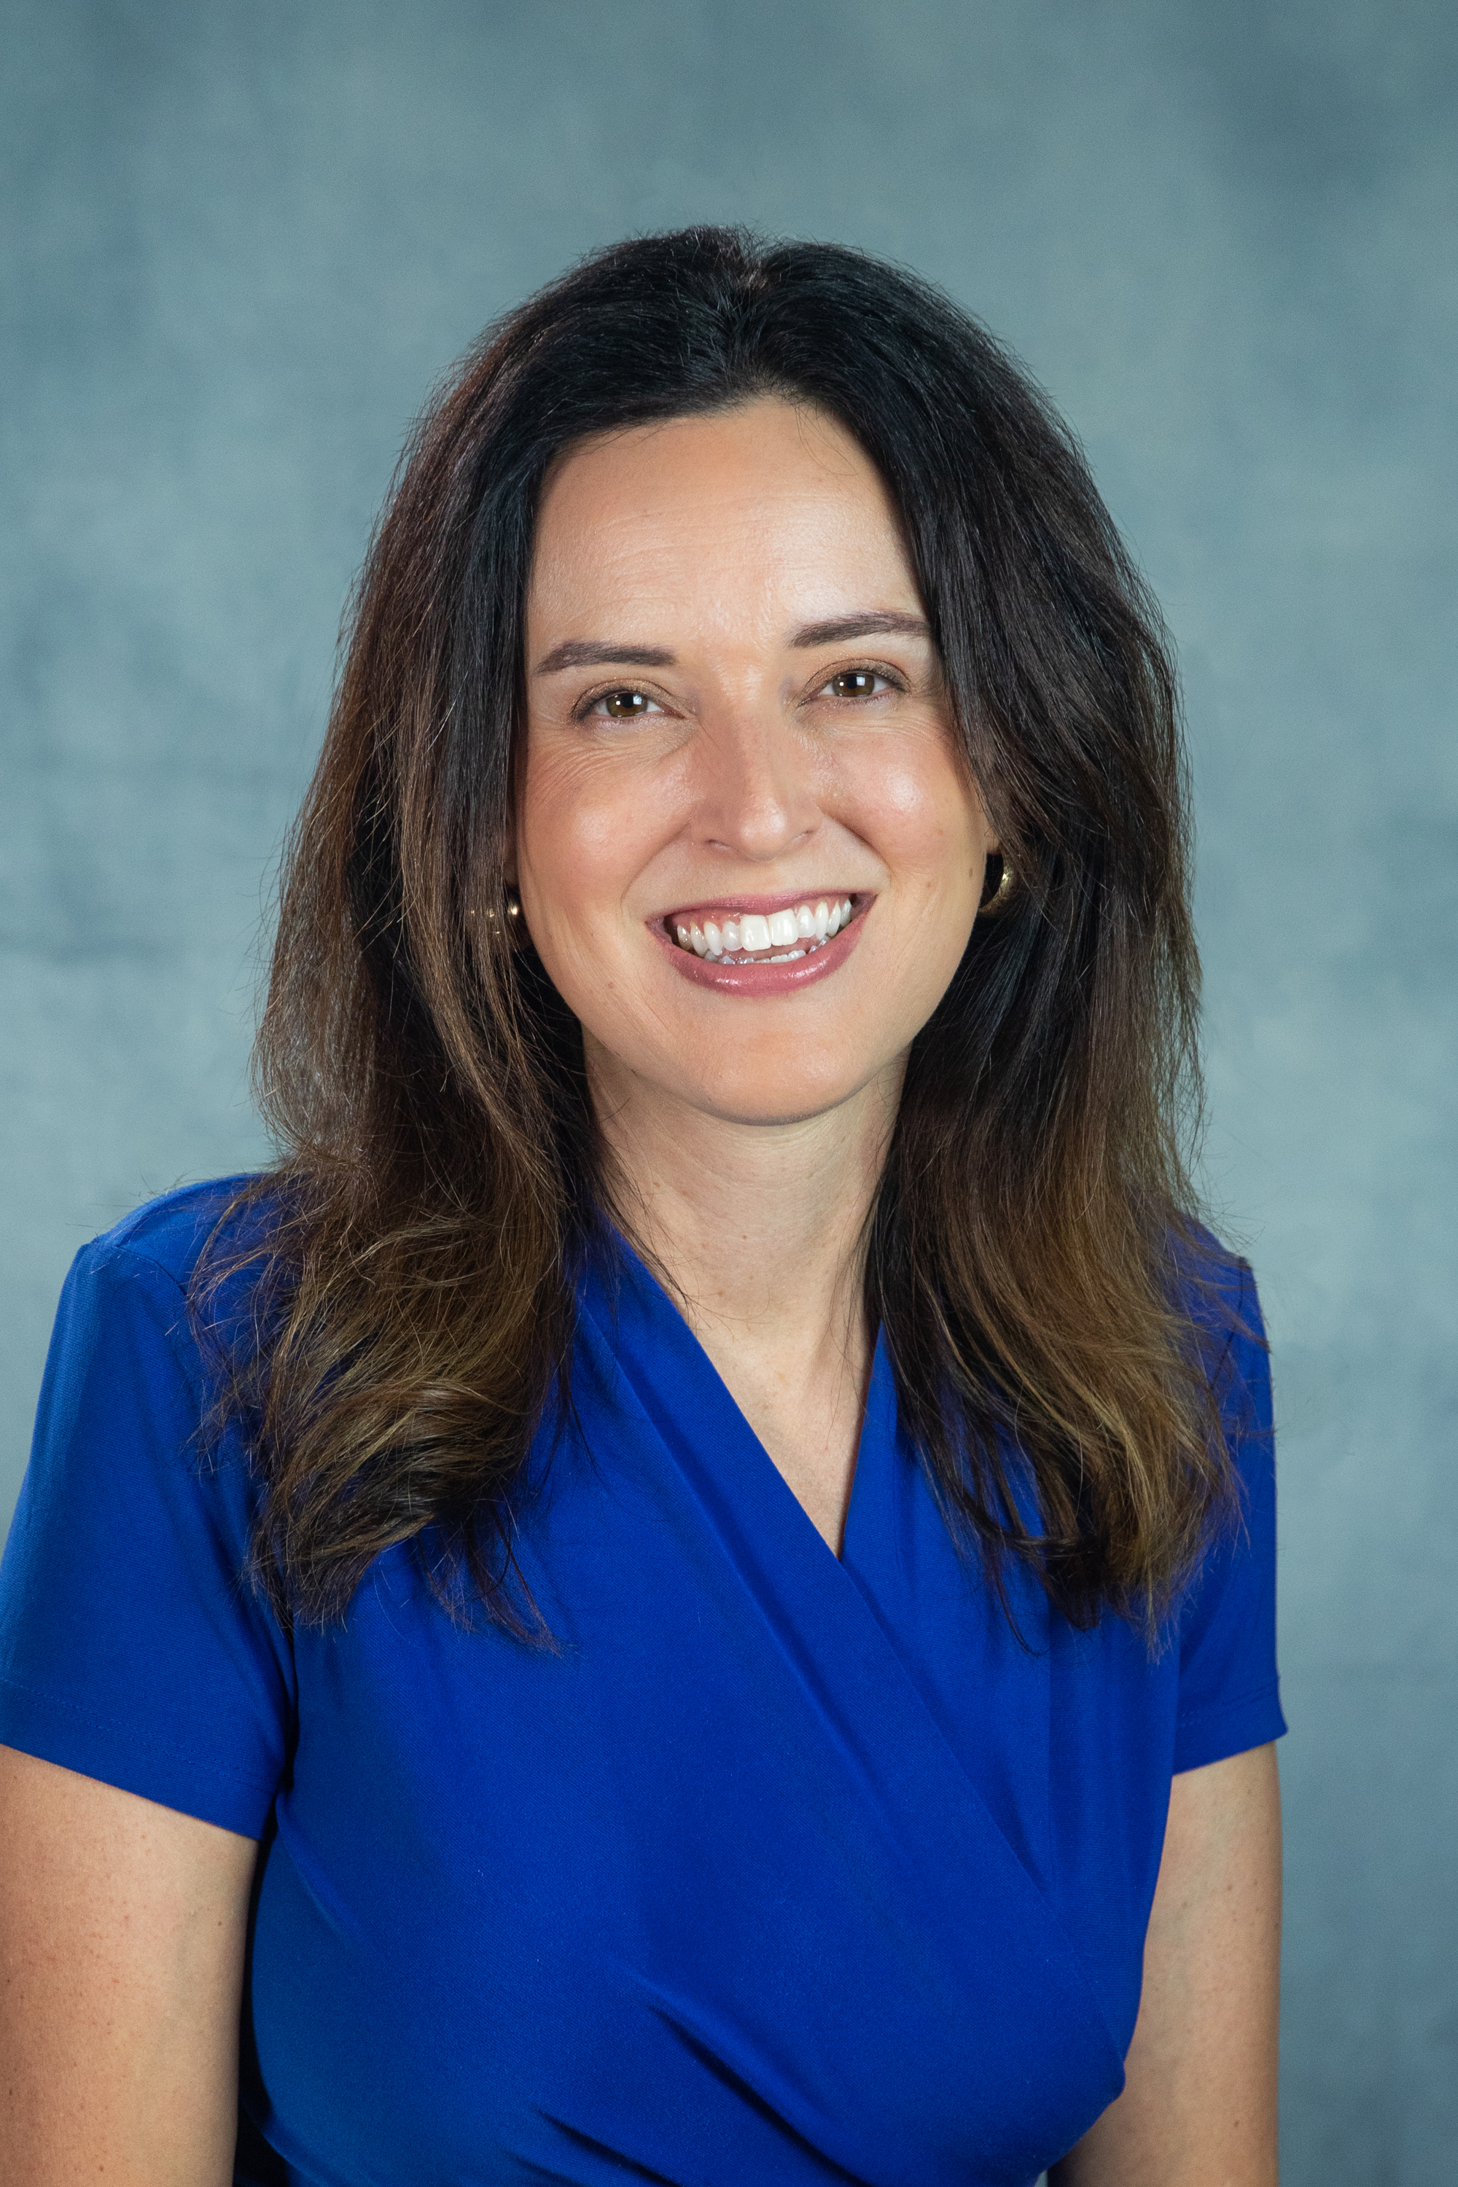
Contact Information
Christy Todd
2024 Georgia Teacher of the Year
christy.todd@doe.k12.ga.us
Twitter: @2024GaTOTY
Facebook: GATeacher​
#GaEduConnects

