Slide 1
Georgia Education Budget Primer
Stephen J. Owens, Ph.D.
January 5, 2024

Slide 2
What we do
Mission: To advance lasting solutions that expand economic opportunity and well-being for all Georgians
Vision: A fair and inclusive Georgia where all people prosper

Slide 3
Where we stand: K-12 education budget (FY24)
Overview:
K-12 Education funding makes up 38.3 percent of the state’s budget
Department of Education - $11.9 billion
State Health Benefit Plan increase - $840 million
Un-obligated surplus - $10.7 billion

Slide 4
How does Georgia stack up?
Equity - $1,750 per pupil more for high poverty schools (11th)
Adequacy - $2,238 per pupil below national average (36th)
Support for low-income folks
High fines and fees, no Medicaid expansion, strict cash assistance, barely any childcare supports, neglect as top reason CPS is called, etc.
Georgia’s history of white supremacist policies have cemented a relationship between race and wealth therefore policies that support low-income kids are a tool of racial justice.

Slide 5
Pupil Transportation takes inflationary hit
State investment has lowered from 54 percent in 1991 to 17 percent in 2023

Slide 6
The missing piece: An Opportunity Weight for students in poverty

Slide 7
State Health Benefit Plan Increases
By the numbers
$846,122,505 – Amount needed to recognize increase for certified school employees (FY24)
$228,992,430 – Amount schools must pay for non-certified employees (FY24)
44 percent – A recent GBPI survey of school leaders found that a plurality of districts would be forced to reduce their workforce if state funding does not increase

Slide 8
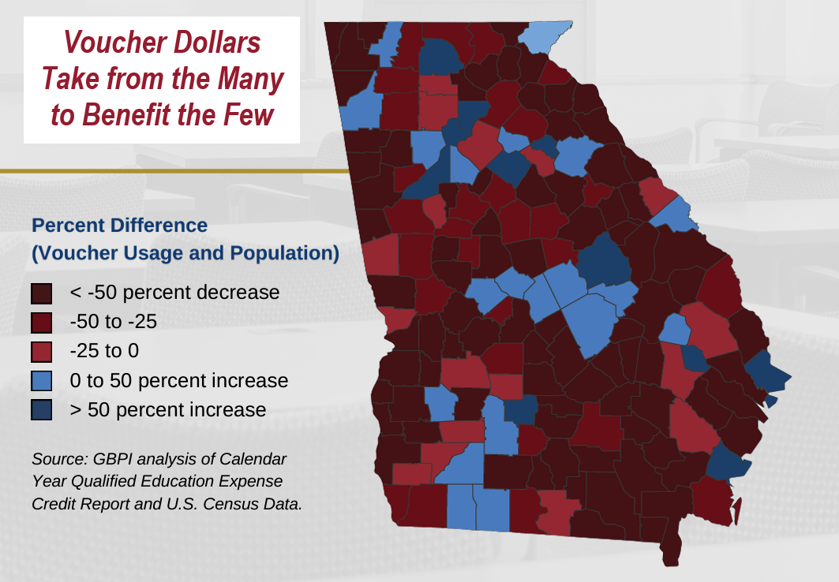
State funding for private school pulls from rural Georgia
Thirty-one percent of the voucher dollars last year were funneled to just two counties: Fulton and DeKalb.
Priorities comparison:
Sparsity grants – Prorated at 73 percent
Qualified Education Expense Tax Credit - $120m annually

Slide 9
Continued Healthy Investment in TRS
Georgia lawmakers have always paid ADC
Even as employer contribution increased steadily from FY 2006 to FY 2019
Relatively generous benefit for vested members
One of the highest in the Southeast, but with a longer vesting period
Pension hovers around 76 percent funded
Significantly lower investment expense – 0.06 percent
National average – 0.44 percent

Slide 10
2024 At-A-Glance
Significant surplus
Cost to replace every school bus in Georgia (~$2.7b) is less than a third of the unobligated surplus amount
School safety grants
Vouchers (womp womp)
Senate Bill 233 contains flaws that other state’s weak voucher bills should warn us from

Slide 11
Questions?

Slide 12
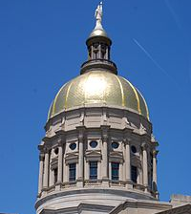
Website: gbpi.org Email: sowens@gbpi.org Phone: (404) 420-1324 x105 Twitter/TikTok: @StephenJOwens_

