Slide 1
Addressing Student Mental Health Needs:
How Metro RESA Can Assist
Granville T. Freeman III, LPC, CPCS, CCTP, BC-TMH
Wraparound Coordinator and Mental Health Coordinator
Metropolitan Regional Service Agency | Metro RESA | www.mresa.org

Slide 2
What we know.
Metropolitan Regional Service Agency | Metro RESA | www.mresa.org

Slide 3
Pandemic
Virtual
Learning
Academic
Disruptions
Mental Health
Crisis
March of 2020 changed the world and more specifically the academic community
Avenues of delivering education were thrust into the digital space, while everyone pivoted
Negative impact on enrollment, engagement and academic achievement
Exacerbated current mental health concerns and revealed others
Metropolitan Regional Service Agency | Metro RESA | www.mresa.org

Slide 4
Who we are.
Metropolitan Regional Service Agency | Metro RESA | www.mresa.org

Slide 5
Servicing the largest academic area in the state of Georgia, Metro RESA prides itself on being innovative and current in what is offered to its school districts. From endorsements to professional development and coaching, Metro RESA in under the direction of GaDOE, supports the metro Atlanta academic community.
Atlanta Public Schools
Buford City Schools
Clayton County Schools
Cobb County Schools
Decatur City Schools
DeKalb County Schools
Douglas County Schools
Forsyth County Schools
Fulton County Schools
Gwinnett County Schools
Marietta City Schools
Rockdale County Schools
Metropolitan Regional Service Agency | Metro RESA | www.mresa.org

Slide 6
What we are doing.
Metropolitan Regional Service Agency | Metro RESA | www.mresa.org

Slide 7
Addressing Mental Health
Alternative Means of Discipline
Restorative vs. Punitive
Holistic Approach to Student Mental Health
Ongoing Coaching
Starting with leaders, staff, students and families.
“A dysregulated adult cannot regulate a dysregulated child”
Providing a coach/thought partner through the process
Collaborative Leadership
Community partnerships.
Metropolitan Regional Service Agency | Metro RESA | www.mresa.org

Slide 8
Holistic Approach to Student M.H.
Maintaining Staff Wellness: Leaders Guide to Manage Staff Mental Health
A one-hour training, provides insight on ways educational leaders can encourage staff connectivity through attention to emotional wellness and an understanding of how different types of grief could be affecting staff behavior and morale. Participants will learn how to assess the climate of their staff and utilize available resources. This session will also provide tips to utilize during staff meetings, ways to encourage the use of Employee Assistance Program (EAP) services, and recommendations for a human resources re-campaign for EAP service solicitation.
Metropolitan Regional Service Agency | Metro RESA | www.mresa.org

Slide 9
THINK S.E.L. WITH STAFF – If we are putting in work to assist students with their social-emotional learning, we should do the same with staff. Through a collaboration between YALE Center for Emotional Intelligence and CASEL, they identified the top 5 most mentioned feelings by over 5,000 teachers anxious, fearful, worried, overwhelmed and sad.
Metropolitan Regional Service Agency | Metro RESA | www.mresa.org

Slide 10
Ways to Address Staff Wellness
Daily Check-ins (optional) – Provide a way for staff to check in to “take a personal inventory of their emotions and ask for help if they so desire”.
Note: If this is a task that may be too cumbersome to embark on, do not do it or start it. This could potentially have an opposite effect on the climate in the building for staff morale.
Metropolitan Regional Service Agency | Metro RESA | www.mresa.org

Slide 11
Ways to Address Staff Wellness
Educational Opportunities – MHAT Trainings and workshops available for your district/staff. Healthier Generations RISE initiative: Resources available for staff regarding wellness.
Note: We have partnered with other agencies in the area that are doing additional trainings that could benefit staff professional development within the subject matter of “wellness”. One is Cobb Collaborative that offers Community Resiliency Model (CRM), Connections Matter, & Connect Now
Metropolitan Regional Service Agency | Metro RESA | www.mresa.org

Slide 12
Ways to Address Staff Wellness
Encourage Connections – Wellness accountability partners. Encourage community within the building, and additional connections that may not include you as the leader.
Note: Including opportunities for staff to engage with one another allows for the them to develop healthy adult connections within the school environment. Having a connection with someone else allows for them to manage stress, expand their circle of support, and develop accountability partners where needed.
Metropolitan Regional Service Agency | Metro RESA | www.mresa.org

Slide 13
Develop a Gratitude Practice
Develop A Gratitude Practice
How to Implement
Ensure that you think about a few things when implementing a gratitude practice that is consistent: Formalized Opportunity (in-person and virtual, Respectful of staff time (don’t impede on planning time).
When practiced regularly, gratitude can significantly increase our well-being and productivity. It has been shown to improve life satisfaction and happiness, help build peer connections, and decrease feelings of anxiety and depression as well as peer conflict.
01
02
Be Authentic and Ongoing
Assess Types of Gratitude
Make sure that gratitude is being expressed in a meaningful way, not because we “have to do it”.
There are 4 types of gratitude that one can choose from: Public Recognition, Private Recognition, Acts of Service, and Notes & Gifts
04
03
Metropolitan Regional Service Agency | Metro RESA | www.mresa.org

Slide 14
Holistic Approach to Student M.H.
Reboot, Refresh, and Rejuvenate: Educators Self-Care Toolkit
A two-hour training, focuses on secondary traumatic stress, burnout and work-place fatigue. Participants will discover how to identify these symptoms while also learning the necessary steps and techniques needed to decrease the negative effects of burnout and workplace fatigue. A self-care plan will be developed so participants can be intentional about the things they wish to do to manage their self-care and wellness.
Metropolitan Regional Service Agency | Metro RESA | www.mresa.org

Slide 15
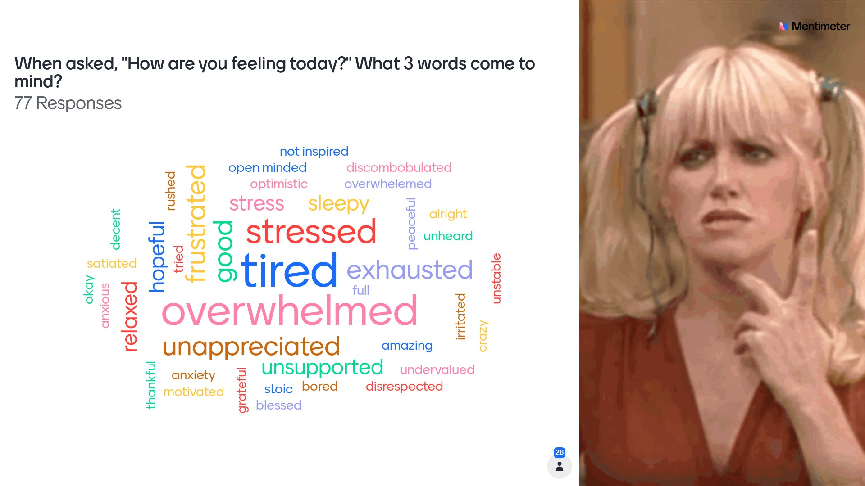
Metropolitan Regional Service Agency | Metro RESA | www.mresa.org

Slide 16
Stages of Grief
Metropolitan Regional Service Agency | Metro RESA | www.mresa.org

Slide 17
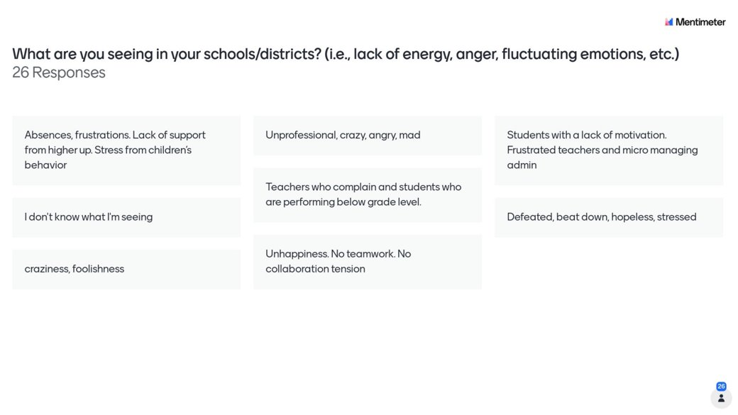
Metropolitan Regional Service Agency | Metro RESA | www.mresa.org

Slide 18
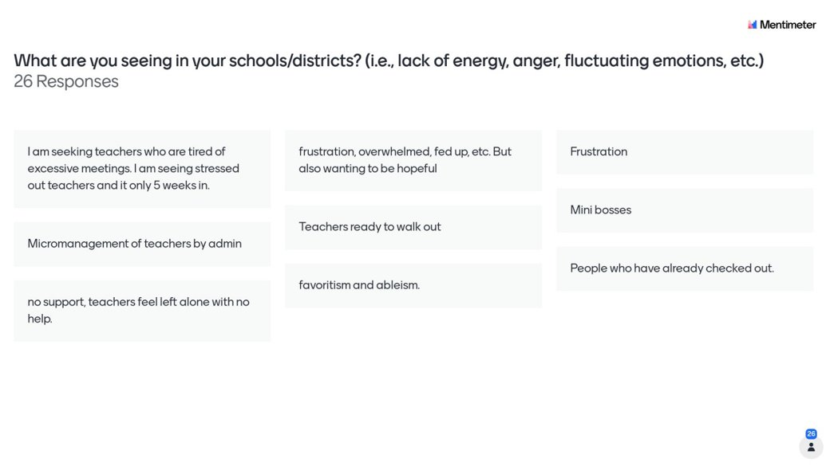
Metropolitan Regional Service Agency | Metro RESA | www.mresa.org

Slide 19
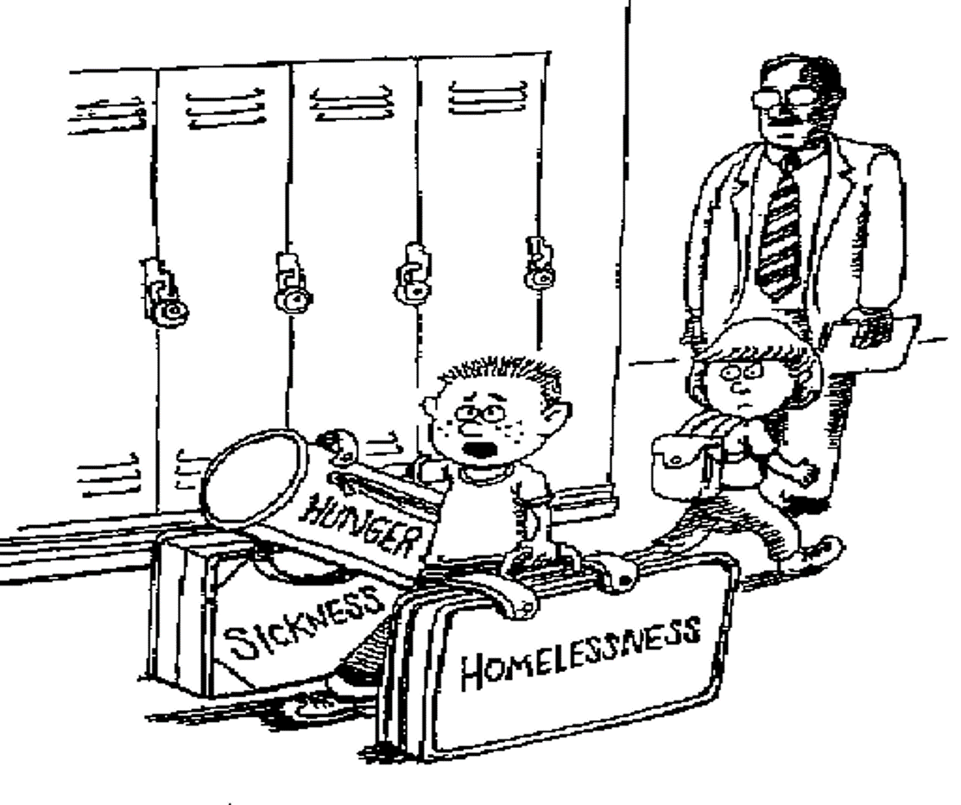
Metropolitan Regional Service Agency | Metro RESA | www.mresa.org

Slide 20
Metropolitan Regional Service Agency | Metro RESA | www.mresa.org

Slide 21
Metropolitan Regional Service Agency | Metro RESA | www.mresa.org

Slide 22
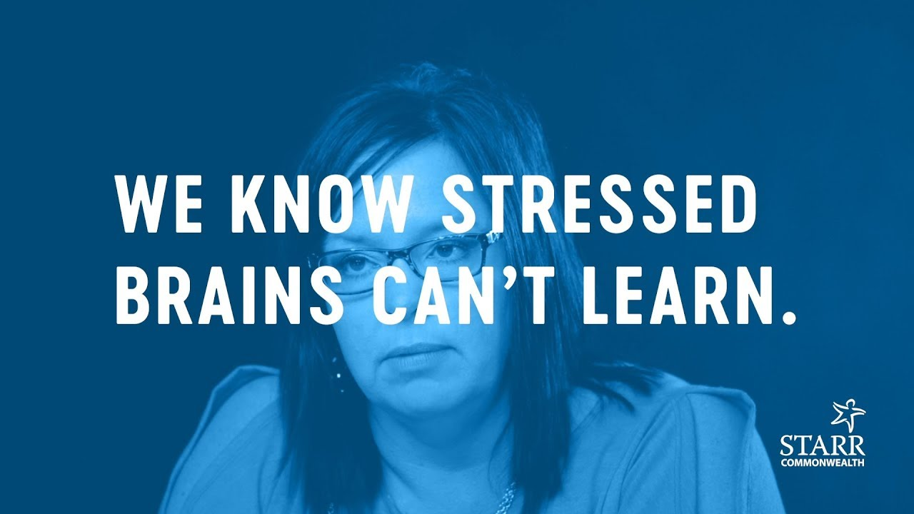
Holistic Approach to Student M.H.
10 Steps to Create a Trauma-Informed and Resilient School
In this two-day, foundation-setting learning experience created by Starr Commonwealth, participants are walked, step-by-step, through the 10 steps to create a trauma-informed, resilience-focused school. The learning experience will focus on resilience with an emphasis on understanding how trauma impacts children and their school experience. It will provide proactive strategies such as fostering connections, prioritizing social and emotional skills, establishing safety, and promoting play. Detailed information and concrete actions will also be covered, and in a way that doesn’t just answer the “why” but also the “how” to create the best classroom and school supports for traumatized students and the school professionals who serve them.
Metropolitan Regional Service Agency | Metro RESA | www.mresa.org

Slide 23
Holistic Approach to Student M.H.
Youth Mental Health 1st Aid Training
Youth Mental Health First Aid is a 6-hour training primarily designed for adults who regularly interact with young people by teaching them how to help an adolescent (age 12-18) who is experiencing a mental health or addictions challenge or is in crisis. The course introduces common mental health challenges for youth, reviews typical adolescent development, and teaches a 5-step action plan for how to help young people in both crisis and non-crisis situations. Participants will learn how to identify, understand, and respond to signs of mental illness and substance use disorders in youth. Topics covered include anxiety, depression, substance use, disorders in which psychosis may occur, disruptive behavior disorders (including AD/HD), and eating disorders.
Metropolitan Regional Service Agency | Metro RESA | www.mresa.org

Slide 24
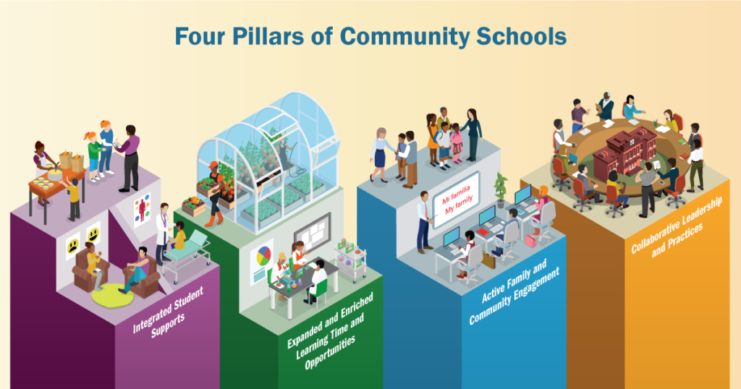
Collaborative Leadership
Community School Strategy
Metropolitan Regional Service Agency | Metro RESA | www.mresa.org

Slide 25
Offering a comprehensive coaching modality that allows each school embarking on implementing this strategy to “transform” their school into a Community School.
Align
Scale
Build
Metropolitan Regional Service Agency | Metro RESA | www.mresa.org
Notes:
Cohort Trainings, Jobalikes, etc.

Slide 26
Community Schools and Wraparound
Trainings: Job-Alikes, Cohort work (district, principals, and school staff)
Coaching: Spending time with identified school-based staff to walk the process with
15+ hours
16+
Through targeted trainings with District Leaders, Principals and School Coordinators
Serving more than 16 schools across 8 counties.
Metropolitan Regional Service Agency | Metro RESA | www.mresa.org

Slide 27
Alternative Means of Discipline
Restorative Practices
Restorative practices is an emerging social science that focuses on how to strengthen relationships between individuals as well as social connections within communities. It is a positive step forward in helping students learn to resolve disagreements, take ownership of their behavior, and engage in acts of empathy and forgiveness. During this two-day training, participants will learn fundamental theory and practices for engaging with students, staff, and parents in their school setting. Topics include how to set high expectations while being supportive, how to provide direct feedback and ask questions that foster accountability, and the most effective methods to resolve common conflicts.
Metropolitan Regional Service Agency | Metro RESA | www.mresa.org

Slide 28
Alternative Means of Discipline
Check & Connect
Check & Connect is an evidence-based mentoring intervention for K-12 students who show warning signs of disengagement with school and who are at risk of dropping out. This one hour and fifteen-minute overview provides education administrator and lead staff (decision-making stakeholders) with an overview of Check and Connect.
Preparation & Implementation Training
Mentor Training
Metropolitan Regional Service Agency | Metro RESA | www.mresa.org

Slide 29
Ongoing Coaching
Areas for Coaching
School Climate
Wraparound
Community Schools
Mental Health
Metropolitan Regional Service Agency | Metro RESA | www.mresa.org

Slide 30
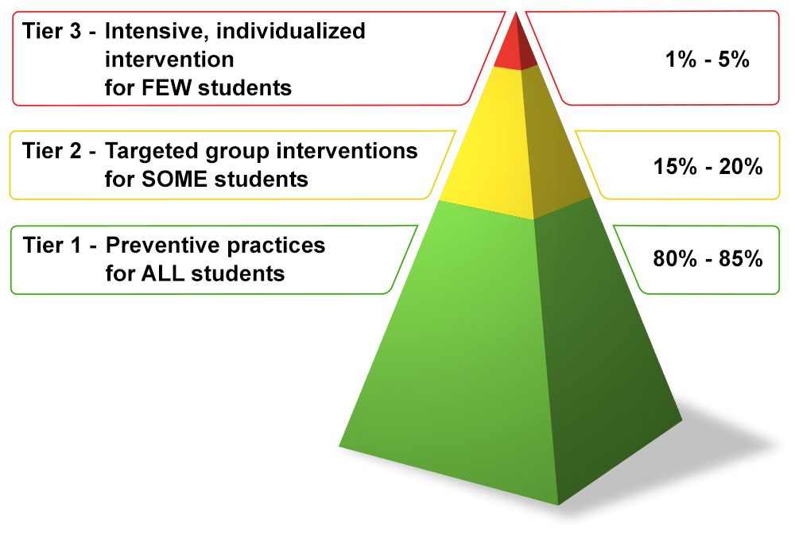
PBIS and School Climate
Positive Behavioral Interventions and Supports (PBIS) is an evidence-based, tiered framework for supporting students’ behavioral, academic, social, emotional, and mental health.
Metropolitan Regional Service Agency | Metro RESA | www.mresa.org
Notes:
Start video at the beginning and stop at 1:31

Slide 31
Questions
Granville T. Freeman III, LPC, CPCS, CCTP, BC-TMH
Mental Health Specialist/Whole Child Supports Coordinator
granville.freeman@mresa.org
Metropolitan Regional Service Agency | Metro RESA | www.mresa.org

