Slide 1
Media Symposium 2023
Richard Woods
State School Superintendent

Slide 2
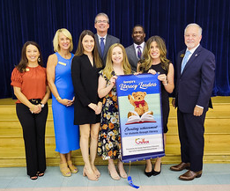
Focus on Literacy
Partnership with Rollins Center to train district & school leaders in the Science of Reading – including Georgia Literacy Academy free to all K-5 teachers and leaders statewide
Created dedicated Director of Literacy role to coordinate GaDOE supports
Recognized 155 schools as Literacy Leaders for exceptional achievement or gains in third-grade reading

Slide 3
2024 GaDOE Literacy Legislative Proposals
Grow the Reading Teacher Pipeline
Expand the “Return to Work" opportunity to include retired teachers with reading endorsements or dyslexia endorsements as a statewide high-need subject area.
Provide SPLOST Flexibility
Expand the allowable use of SPLOST funds to include software, subscriptions, and other digital instructional resources, including high quality instructional materials for literacy.
Sustain Screener Delivery & Support Coaching
Sustain the delivery and availability of GaDOE’s screeners. Support a tiered, statewide coaching model that grows capacity across districts, schools, & classrooms.

Slide 4
Literacy Screeners
One screener to satisfy two legislative requirements: SB 68 (Dyslexia screening) and HB 538 (Universal reading screening)
Rollout: Fall 2024
Comprehensive Formative Tools: Expansion of BEACON (K through high school suite of formative assessments)
Free for all school districts: Since introducing BEACON in 2020, 156 LEAs have explored or used BEACON regularly to support student learning.

Slide 5
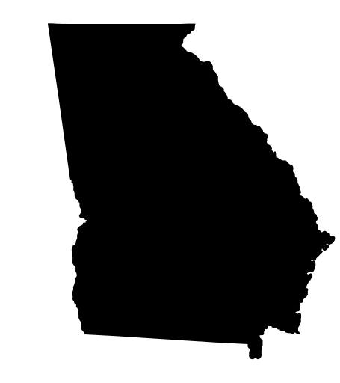
Literacy Coaching
Structured Literacy Coordinator (1)
Full time: Coordinated trainings, resources, and supports.
Regional Coaching (32)
Statewide
approach with
light state-level
footprint
Based in the
Science of Reading
Standardizes supports at
the regional, district, school,
and classroom levels
Effective and efficient use
of funds; can be scaled.
Full time: Literacy coaches trained in the Science of Reading to deliver training, resources, support, and guidance.
District Leaders (181 plus state charters)
Stipends: Literacy leaders identified in every school district and state charter school who are equipped to lead structured literacy efforts.
School Coaches (Elementary Schools)
Stipends: Identify existing literacy coaches, instructional coaches, master teachers, teacher leads, department heads, etc. who are trained to support their colleagues.

Slide 6
Former Mississippi Superintendent Dr. Carey Wright:
A strong role for the state’s Department of Education, training grounded in the science of reading, and a tiered coaching approach that aligns supports at the state, regional, district, and school levels were key components that made up the secret sauce in Mississippi’s recipe for reading gains.
They must be applied in Georgia.”
EMBARGOED UNTIL 5 P.M. TODAY: Joint op-ed with former MS Supt. Dr. Carey Wright

